Slide 1
Putting an End to Child Labor in Chocolate
Through Consumer Action
& Fair Trade
Elizabeth O’Connell
Fair Trade Coordinator, Green America
April 6, 2011

Slide 2
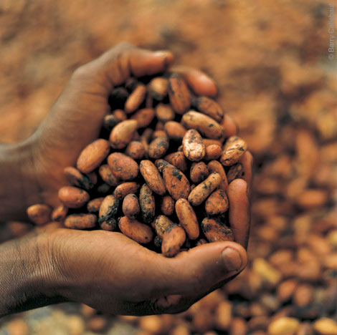
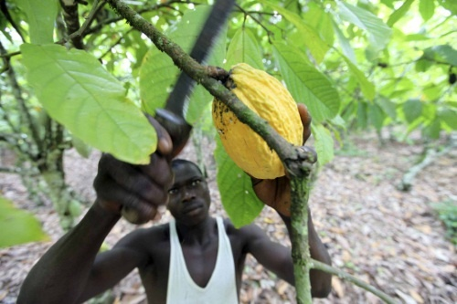
Overview
Introduction
Contradictions in the Global Chocolate Market
Fair Trade Certification
Ways to Take Action
Notes:
2

Slide 3
Green America
Green = Environmental Sustainability & Social Justice
Green America is the nation’s leading Green Economy organization. We provide economic strategies, organizing power and practical tools for businesses and individuals to solve today's social and environmental problems.
Green America is comprised of:
Business Members and Individual Members who all
take action in our green economy campaigns
Notes:
3

Slide 4
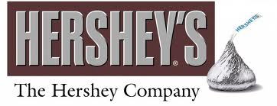
Big Chocolate
Roughly 3 million tons of cocoa are harvested each year
In 2010, global chocolate sales reached $50 billion
Chocolate company CEO’s were given approximately $35 million in compensation
Nestle CEO was given $11.4 million
Kraft/Cadbury CEO was given $13.5 million
Hershey CEO was given 10.5 million
Mars undisclosed
Notes:
The chocolate industry is a steadily growing at about 3% per year,
Last year $50 billion worth of chocolate were sold world wide, 16 billion in the US.
Big Chocolate, as it is also called, is essentially an oligopoly between major international chocolate companies in Europe and the U.S. Last year Mars and Hershey’s alone generated $13 billion a year in chocolate sales, out of 16billion overall.
Hershey is the largest chocolate manufacturer in the US and holds 42% Market share within the US
Chocolate sales are increasing at about 3%/year as more of the world develops a taste for chocolate
4

Slide 5
Big Contradictions
Chocolate is consumed widely on 5 out of 7 continents
70% of the world’s cocoa comes from West Africa from nearly 2 million cocoa farmers
In 2010, The US Department of Labor reported that cocoa from 5 countries was likely produced with labor in violation of international standards:
Ivory Coast - Child labor, forced labor
Ghana - Child labor
Cameroon - Child labor
Nigeria - Child labor, forced labor
Guinea - Child labor
Notes:
Chocolate is consumed widely on 5 out of 7 continents, the exclusions being Antarctica and africa, yet 70% of the world’s cocoa comes from West Africa. Ivory coast alone grows more than 40% of the world’s cocoa.
Cacao cultivation is restricted to the hot, humid belt 10 to 20 degrees north and south of the equator.
Nearly 2 million cocoa farmers live in this region, depending on cocoa for their livlihood. few of these farmers have have ever tried chocolate, many do not even know what the beans are for
In 2010, The US Department of Labor released it’s “list of goods produced with child labor or forced labor” his list reported that cocoa from 5 countries was likely produced with labor in violation of international standard all our in west africa. This is despite the 9 years that had passed since industry signed the Harkin Engel protocol commiting to put an end to this issue in 2005.
Child labor persists in
Ivory Coast - Child labor, forced labor
Ghana - Child labor
Cameroon - Child labor
Nigeria - Child labor, forced labor
Guinea - Child labor

Slide 6
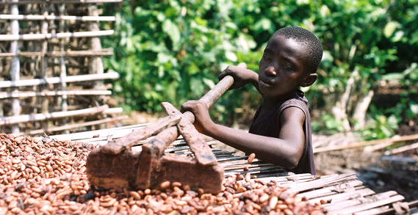
Underlying Issue: Poverty
The profitability of the industry is in stark contrast to the reality for cocoa farmers living in West Africa
Low income means farmers can not cover costs of sustainable production
To harvest enough make any cash at all, farmers must resort to the cheapest forms of labor
Vicious cycle: Kids who work in cocoa fields, instead of going to school, will not be able to escape poverty
Notes:
The fact that the main ingredient of the 50 billion dollar cocoa industry is grow by the hands of children and individuals who are not compensated for their labor appalling.
The profits amassed by big chocolate are in stark contrast to that of cocoa cocoa farmers in West Africa. These farmers are unable to cover their costs of production, and therefore must resort to child and forced labor.
Because farmers are paid such low prices for their cocoa they are unable to cover costs of sustainable production
In order to harvest enough cocoa to make any cash at all, farmers must resort to cheap labor: child, trafficked, and forced labor.
Children who grow up experiencing the worst forms of child labor, instead of attending school, will not be able to escape poverty
This leads to another one of chocolate’s major contradictions - While chocolate is a favorite of kids at home, children on the other side fo the world, as young as 6 have been reported to work their lives away on cocoa farms.

Slide 7
Solution: Fair Trade
Fair Trade ensures:
Payment of a Fair Price
More direct and long-term trade relationships
Democratic and Transparent cooperatives
Funds for community development projects
Training programs and technical assistance
for farmers
Strictly prohibits the use of child and forced labor
Notes:
In order to prevent child labor, the root cause of poverty must be addressed. Farmer livelihoods must be improved so that they no longer need to rely on free and exploitive labor.
Fair Trade is one system of getting at the issue of paying farmers more. Fair Trade certification ensures that cocoa farmers receive a fair price for their harvest, creates direct trade links between farmer-owned cooperatives and buyers, and provides access to affordable credit to farmers so that they do need to go into debt to complete their harvest. Additionally, Fair Trade sets aside funds to be used for community development projects, as decided on by the cooperative. Fair Trade also emphasizes training programs.
Additionally, Fair Trade certification is so far the best way to monitor whether child labor has been used to grow chocolate. Fair Trade strictly prohibits the use of slave and child labor, and discrimination, additionally fair trade protects workers collective bargaining rights. Fair Trade policies and procedures in place for remediation of children found to be in exploitive labor conditions. FLO has an internal task force on child labor and requires producer partners to set up internal systems to identify and eliminate child labor.
FLO International, the standard setting body, audits cooperatives on an annual basis, to ensure Fair Trade principles are being met. FairTrade USA the certifying body in the US ensures fair trade brands are paid according to Fair Trade standards.

Slide 8
Payment of a Fair Price
Guaranteed Minimum Floor Price
Fair Trade Certified Cocoa: $2000/metric ton
Fair Trade and Organic Certified: $2300/metric ton
Social Premium
$200/metric ton is set aside for community development projects
Current Market price
$3020.05/metric ton
When the market price rises above the Fair Trade Minimum farmers receive market rates and the social premium
Notes:
The guarantee of a minimum floor price protects farmer income from falling dramatically as world commodities prices fluctuate.
The current floor price for cocoa is $2000/metric ton. (2300/organic). Additionally, for every metric ton sold $200 goes to the social premium fund which is used for social development projects as decided by the coop.
Current market price = 3020.05. This is higher than the Fair Trade floor price. In this case Fair Trade farmers earn market price, plus social premium. FT protects farmers from unexpected drops in market price.

Slide 9
Payment of a Fair Price
Notes:
Fair Trade minimum is 2000/ton, what is considered a living wage, and covers the cost of sustainable production (many FT orgs pay more than this in fact, especially as cocoa quality improves.)
The Red Line on this graph shows the FT minimum floor price of $2000/ton a pound. The Gray represents the market price.
Market price has fluctuated over the past ten years from $700/ton to more than $3000.
Fair Trade cocoa was first imported to the US in 2002. Between 2002 and 2003 and again in 2004-2007, farmer incomes fell below the fair trade recommended minimum price for cocoa. Paying less than the fair trade price doesn’t cover the cost of production and farmer ends up further in debt at the end of the growing season and are forced to rely on free or very cheap labor.
In these times farmers still earned the FT price, in addition to social premium funds.
In times when market prices rose above FT floor price, or grey above red, the payment to ft farmers increased to market levels. Current market price = 3020.05. You may be wondering what’s the point of FT.
FT farmers still benefit in these scenarios because of the social premium paid to the coops and all the additional benefits of fair trade I mentioned previously.

Slide 10
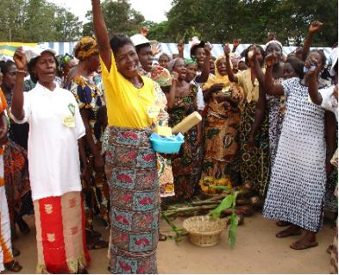
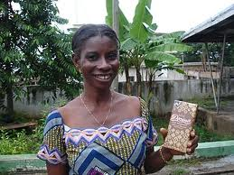
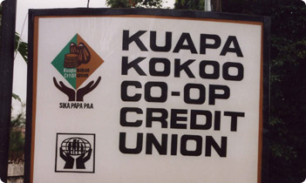
Additional Benefits of Fair Trade
Opportunities for Women
Democratic Cooperatives
Community Development
Notes:
To give some examples of the benefits of fair trade, besides fair price, I would like to refer to Kuapa Kokoo, the largest FT coop, in ghana.
Gold Star example: Kuapa Kokoo Coop in Ghana
Est. 1993. Started Divine Chocolate UK in 1998
45,000 registered members in 1,200 villages societies. Each has his or her own farm of 5 hectors or less. Accounts for 1% of world output of coco
They take FT one step further b/c
The african farmers of Kuapa Kokoo own 1/3 of Divine Chocolate USA, and 45% of Divine UK
have two seats on the board
receive a share of the profits from Divine chocolate sales on top of the fair price
Fair Trade system benefits kuapa through the creation of Democratic and transparent cooperative:
These coops give farmers collective bargaining power
Empowers farmers to be in control of their own destiny - -no plantation with a master
coops give farmers greater direct access to western markets
Finally, coops are organized to use social premium funds to meet the needs of the community. one person = one vote
Fair Trade also works to create O\opportunities for women
Kuapa aims to enhance the active and effective participation of women in decision making throughout the organisation.
Measures have been introduced to ensure that a minimum number of members of the various councils and committees are women. Over time this has ensured women have more influence and make more contributions to the organisation. In 2008 more women than men were voted onto the Kuapa National Executive, and women hold some of the most senior positions.
Further special seminars and workshops are organised for women on a wide range of issues, for example nutrition, child care, health and credit facilities.
Finally, Fair Trade offers the social development fund or fair trade premium
This means that for each fair trade product sold, a certain amount of money (above and beyond the fair price/living wage/high hourly wages) is set aside for community development. In chocolate this amount is 200/ton
-this $ is used for whatever the workers want. They decide, democratically, how to invest this money.
examples of projects funded by the Kuapa Kokoo Coop with FT premium money:
Built water wells to give clean, potable water to villages
Built schools and hired teachers
Farmer Training programs:
quality improvement trainings, organic certification, pest management and disease prevention
women’s workshops to teach small-scale business and entrepreneurship skills – business principles, accounting, etc.

Slide 11
What can we do as consumers?
“Never doubt that a small group of thoughtful, committed citizens can change the world. Indeed, it is the only thing that ever has.”
- Margaret Mead
Support campaigns that pressure major chocolate companies to improve their sourcing policies and labor rights practices
Write to your representatives
Support Fair Trade products and companies
Spread the word to your community
Notes:
So given the fact that we are all know aware of these issues in chocolate, what can we do? Given the scale of the problem, and the power of major chocolate companies it can appear helpless, but improvement is possible.
As consumer we actually hold a great deal of power. Companies will change their practices if they fear losing demand. And organized consumer campaigns threaten the image of he most popular chocolate companies, something they don’t want.
So to tackle this issues we recommend-
Support campaigns that pressure major chocolate companies to improve their sourcing policies and labor rights practices
We do not suggest a boycott, but rather writing, calling, emailing cocoa companies and letting them know how important this issue is to you. The more they hear from consumers about Fair Trade, the more likely they will be to take a hard look at labor issues.
We also suggest writing to your lawmakers, supporting Fair Trade companies that are part of the green economy, and telling your communities about these issues to increase awareness.

Slide 12
Consumer Campaign Successes
Date | Company | Commitment
Mar 2009 | Cadbury | Commits to a Fair Trade Dairy Milk bar in UK and Ireland, then in Canada, Australia & NZ
Dec 2009 | Nestle | Announces Fair Trade Kit Kat in UK
Jan 2010 | Green & Blacks | Commits to shift to 100% Fair Trade
Feb 2010 | Ben & Jerry’s | Commits to shift to Fair Trade for all imported ingredients by 2013
Jan 2011 | Barry Callebaut | Makes its 4 classic recipes Fair Trade
Feb 2011 | Bon Apetit | Switches to using Fair Trade cocoa in its 400 kitchens across the US
Notes:
To brighten the mood here, I thought I’d share a few examples of improvements the chocolate industry has made, in regards to fair trade.
These successes are directly related to consumers demanding more from their chocolate manufacturers.
As you can see many of these developments have happened in europe, where consumers are more aware of these issues, and more educated as far as looking for a fair trade label. Here in the states, we are working on it, and seminars like this are helping.
You’ll notice a few companies missing from this list. Mars has recently made commitments to shift its entire to supply chain to rainforest and Utz certifications
Hershey however has made no such commitments. This is why our organizations have launched a consumer campaign, pushing hershey to go fair trade.
12

Slide 13
The Raise the Bar, Hershey! Campaign launched in September 2010 with the publication of our alternative CSR report for Hershey
Actions so far:
Two “National Weeks of Action” to screen The Dark Side of Chocolate
Collecting petitions to Hershey - 100,000 signatures
Getting kids involved through Reverse Trick or Treating and making Valentines for Hershey CEO
Rallies at all three Hershey Stores (NYC, Chicago
Upcoming Actions: & Niagara)
Valentine’s Day – Get Involved!
www.RaiseTheBarHershey.org
Notes:
GA GX and ILRF We launched the campaign by publishing an Alternative CSR report in september 2010, the same day hershey released their first ever csr report.
With Robin Romano, we have organized Dark side of chocolate Screenings across the country, and organized focused actions in the weeks leading up to Halloween and Valentines day largest chocolate purchasing holidays of the years (sales figures). So far, 2,000 DVD’s have been distributed.
We have had call-in days to Hershey on the National Day Against Child Labor
We have collected over 30,000 signatures on petitions to the Hershey CEO - PASS OUT PETITIONS
Kid Valentines and send them to the hershey CEO ad we even delivered our report to the CEO on valentines day inside of an organic bouquet of flowers.
What we are up to now -
Finally, Brand Jam contest
We are working to engage SRI shareholders to dialogue with hershey
Hershey Rally Times square, June 8, 2011
If any one wants to know more about this campaign you can visit our website, where you can also order the dvd and dowload the report.
Or take one of my cards to get involved in the Rally!

Slide 14
Contact your Representatives
This September was the 10 year anniversary of the signing of the Harkin-Engel Protocol, which major chocolate companies signed to commit ending the Worst Forms of Child Labor in Ghana & Ivory Coast.
Write or call your representatives and senators to let them know this issue is important to you and that the lack of industry progress over the past 10 years is unacceptable
Notes:
Another way to take action is to reach out to our legislatures. As the 10 year anniversary of Harkin-engel protocol approaches, you can write to your representaives let them know how important this issue is to you, and how disappointed you are with the industry’s performance.

Slide 15
Supporting Fair Trade Chocolate
Choose Fair Trade certified chocolate when you shop and as gifts for your loved ones
Take our Chocolate Score Card to the supermarket with you
Find Fair Trade chocolate companies online at www.GreenPages.org
Some Brands to look for:
Alter Eco
Divine Chocolate
Equal Exchange
Green & Blacks
Notes:
Finally, we can support a green economy, that protects workers rights, by shifting our spending dollars to support companies doing the right thing.
Fair Trade makes a great gift, and a perfect opportunity to tell the story about cocoa and where it comes from.
You can download our Fair Trade Chocolate scorecard (I have copies here) and take it with you when you shop. The back also makes sense of all the labels that are popping up on chocolate products.
Finally, you can find great Fair trade companies in Green America’s national green pages online.
To finish on a positive note, I’ll point out that fair trade sales are up in this country.
In february, Fair Trade USA—a U.S.-based third-party certifier of Fair Trade—reported mainstream consumers are increasing their commitment to Fair Trade faster than ever. According to the report, sales of Fair Trade Certified products increased 24 percent, totaling $170 million during 2010.
Fair trade chocolate sales specifically rose by 19% in 2010, comapred to average industry growth of 3%.
And finally, consumers campaigns work, even it takes a few years for Hershey to commit to our demand of a fair trade Hershey bar, we are building awareness in the process. This campaign also puts the heat on other companies to choose fair trade, as transfair usa let us know that a company they were in dialogue with chose fair trade over another ethical certification because they read our report and were convinced fair trade was the best way to get at the issue, and avoid heat from consumers.
15

Slide 16
Resources
RTBH Campaign Website: www.RaiseTheBarHershey.org
Green America’s Site: www.FairTradeAction.org
Payson Center of Tulane University: www.payson.tulane.edu
US Dept. of Labor List of Goods produced with Forced & Child Labor: www.dol.gov/ilab/programs/ocft/pdf/2009tvpra.pdf
Upcoming Events:
Hershey Rally in June 8: www.RaiseTheBarHershey.org/rally
Green Festival NYC - October 1-2: www.GreenFestivals.org
My email: eoconnell@greenamerica.org
Notes:
Finally, here are resources for more info.
There are 2 upcoming events in NYC I want to bring your attention to
Feel free to email me if you want to get involved in the hershey campaign
16

