Slide 1
Educating Ourselves
about…
INTERCONNECTIONS

Slide 2
Human Bingo
9 squares
5 minutes
Try your best to find a different person for each square

Slide 3
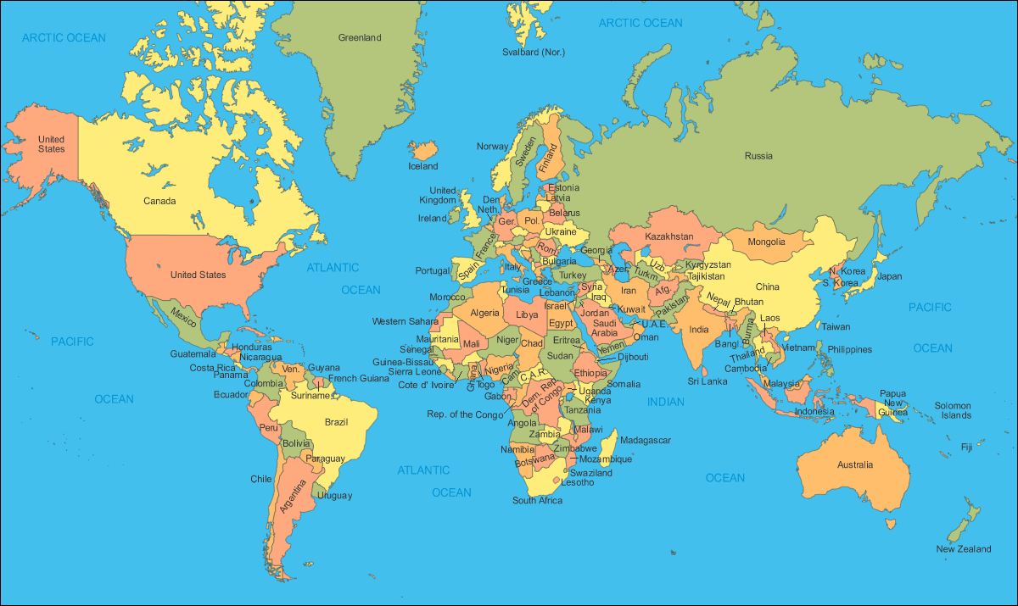
Let’s Map a Few Results

Slide 4
Think Back…
What do you remember about the quote from Dr. Martin Luther King that the 7th Graders read this morning?

Slide 5
So, We’re All Connected
That means our choices affect other people.
We can choose to make a better world.

Slide 6
We Can Make A Difference Through Our Food Choices
What are some of things people consider when choosing food to buy at the grocery store?
For example, people might consider price…

Slide 7
Some Considerations
Where was it produced and processed
What impact does it have on the environment (packaging, how far it traveled, etc.)
Its nutritional value
Whether it’s organic
How the workers who grew it/made it were treated

Slide 8
What’s in Your Shopping Bag?
These are items that might be found in the average grocery bag.
Look at yours to find out where it came from – it’s COUNTRY of ORIGIN, NOT the location of its distributor.

Slide 9
Map It
Carefully place your product on its country or origin on the map on the floor.
If you’re not sure, ask for help.

Slide 10
What Do You Notice?
Look at the products that come from outside the United States.
What do you notice about them?

Slide 11
They’re Food “Staples”
Grown in tropical countries (there’s no “locally grown” option)
Grown in developing countries (more poverty, less access to safe water, medicine, education)
Feature the Fair Trade Logos

Slide 12
Fair Trade Logos

Slide 13
Fair Trade
What does it mean to you?

Slide 14
Fair Trade
Ensures farmers a stable, living wage so they can meet their families’ needs
Makes sure the environment is cared for
Improves communities: schools, wells, health care
Ensures good working conditions

Slide 15
Media: 1st U.S. Fair Trade Town
We’re fortunate to have a lot of stores and restaurants here which carry or use certified Fair Trade items.

Slide 16
Fair Trade Schools
The Fair Trade Schools movement began in the U.K. in 2007 to educate kids like you, who are tomorrow’s consumers.
Today, 1000 schools in the U.K. have been Fair Trade certified, with another 4,000 in the works.

Slide 17
MPFS and Fair Trade
Fair Trade speaks to the values we embrace and teach here at MPFS.
We can all be proud that our school – MPFS – is among the first 13 schools in the U.S. to become Fair Trade certified.

Slide 18
Pair & Share
What can you do to promote Fair Trade?

Slide 19
Mindful Eating & Reflection
Think about…
How we’re all connected
How our choices impact upon others
The lives you’re making a difference in by eating Fairly Traded chocolate

