Slide 1
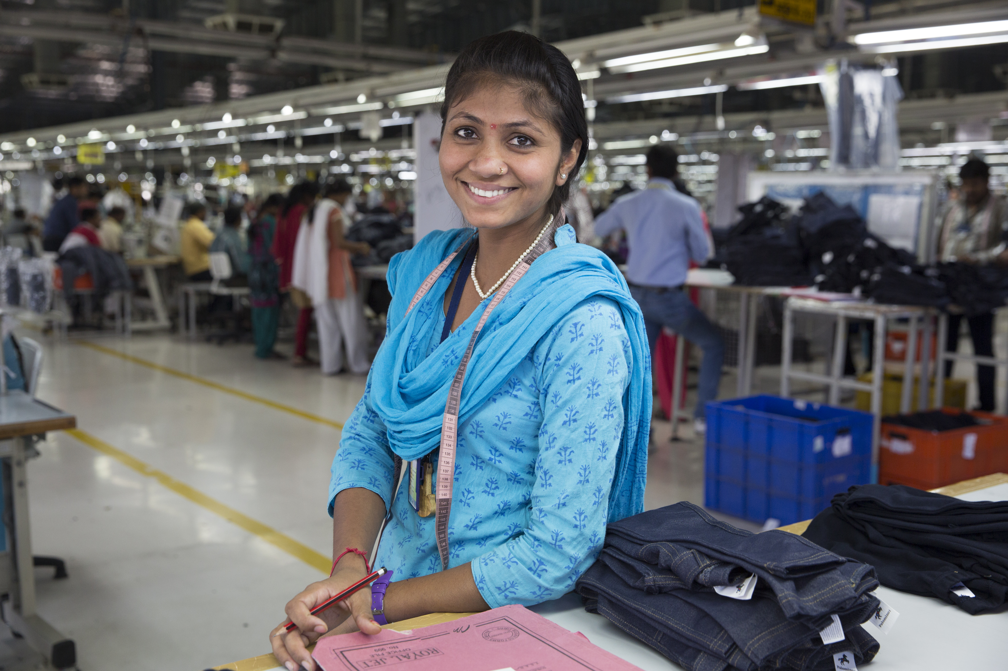
Fair Trade Apparel
Learn More at: www.FairTradeCampaigns.org

Slide 2
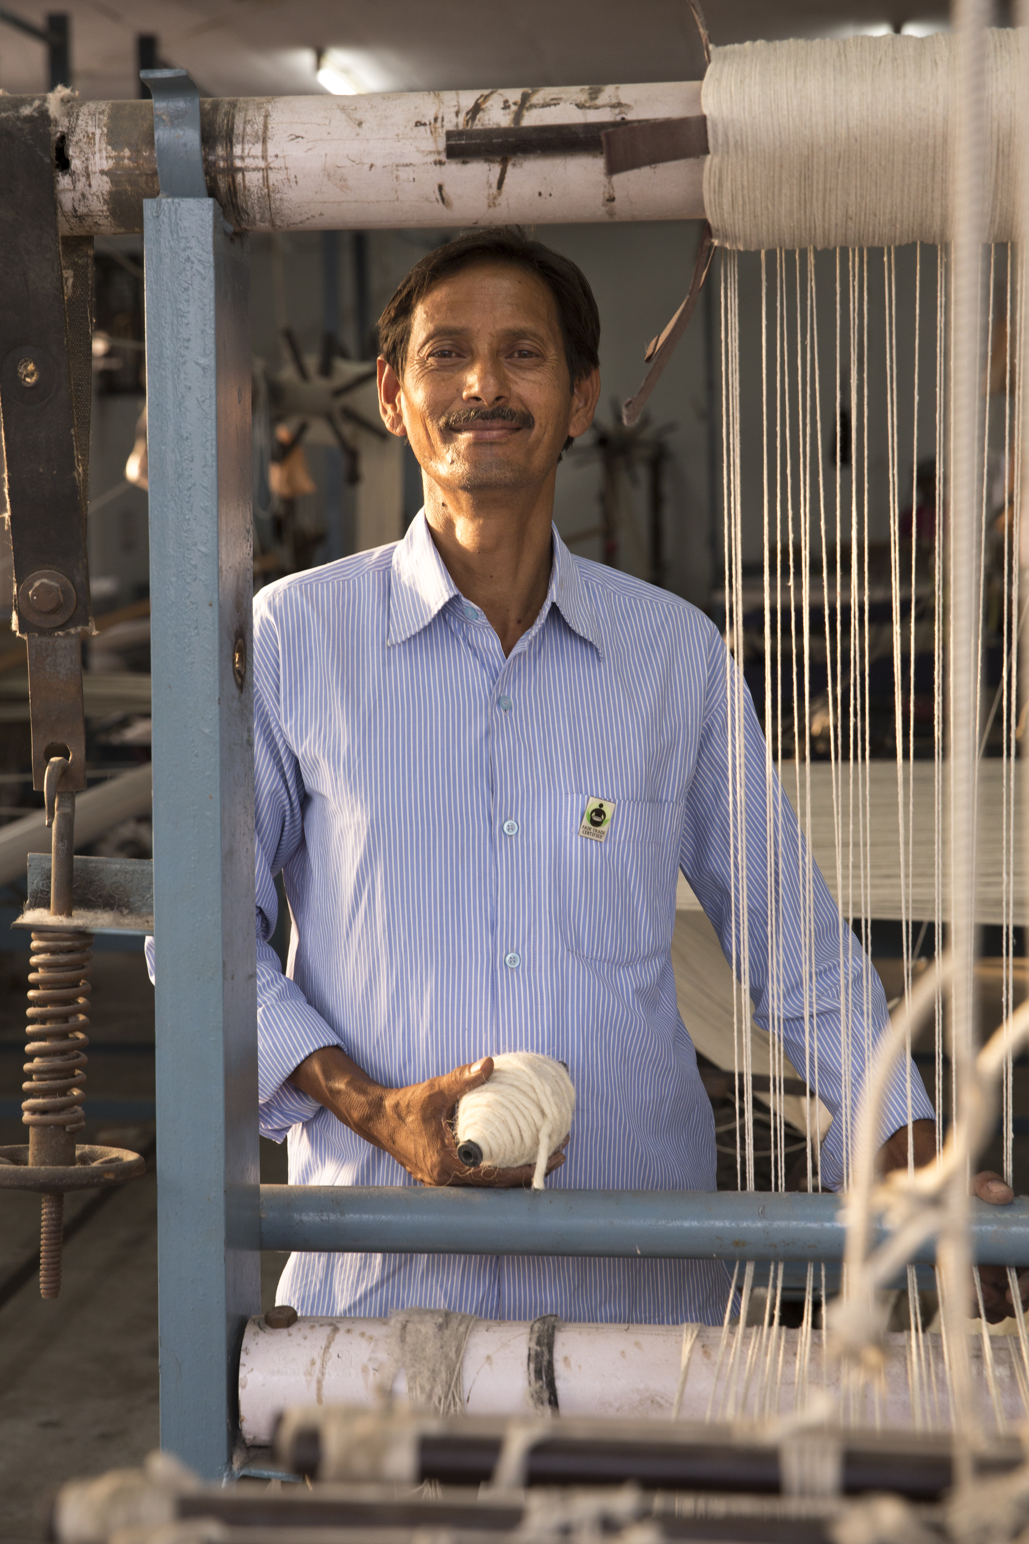
Apparel Fast Facts
Americans purchase 20 billion apparel products each year.
Apparel Factories: Almost three quarters of world clothing exports are made in developing countries such as Thailand and Bangladesh.
Cotton Farms: Cotton uses more insecticides than any other single crop.
Learn More at: www.FairTradeCampaigns.org
Notes:
Farm - Conventionally grown cotton uses more insecticides than any other single crop.
Nearly $2.6 billion worth of pesticides are sprayed on cotton fields each year — accounting for more than 10% of total pesticide use and nearly 25% of insecticides use worldwide.

Slide 3
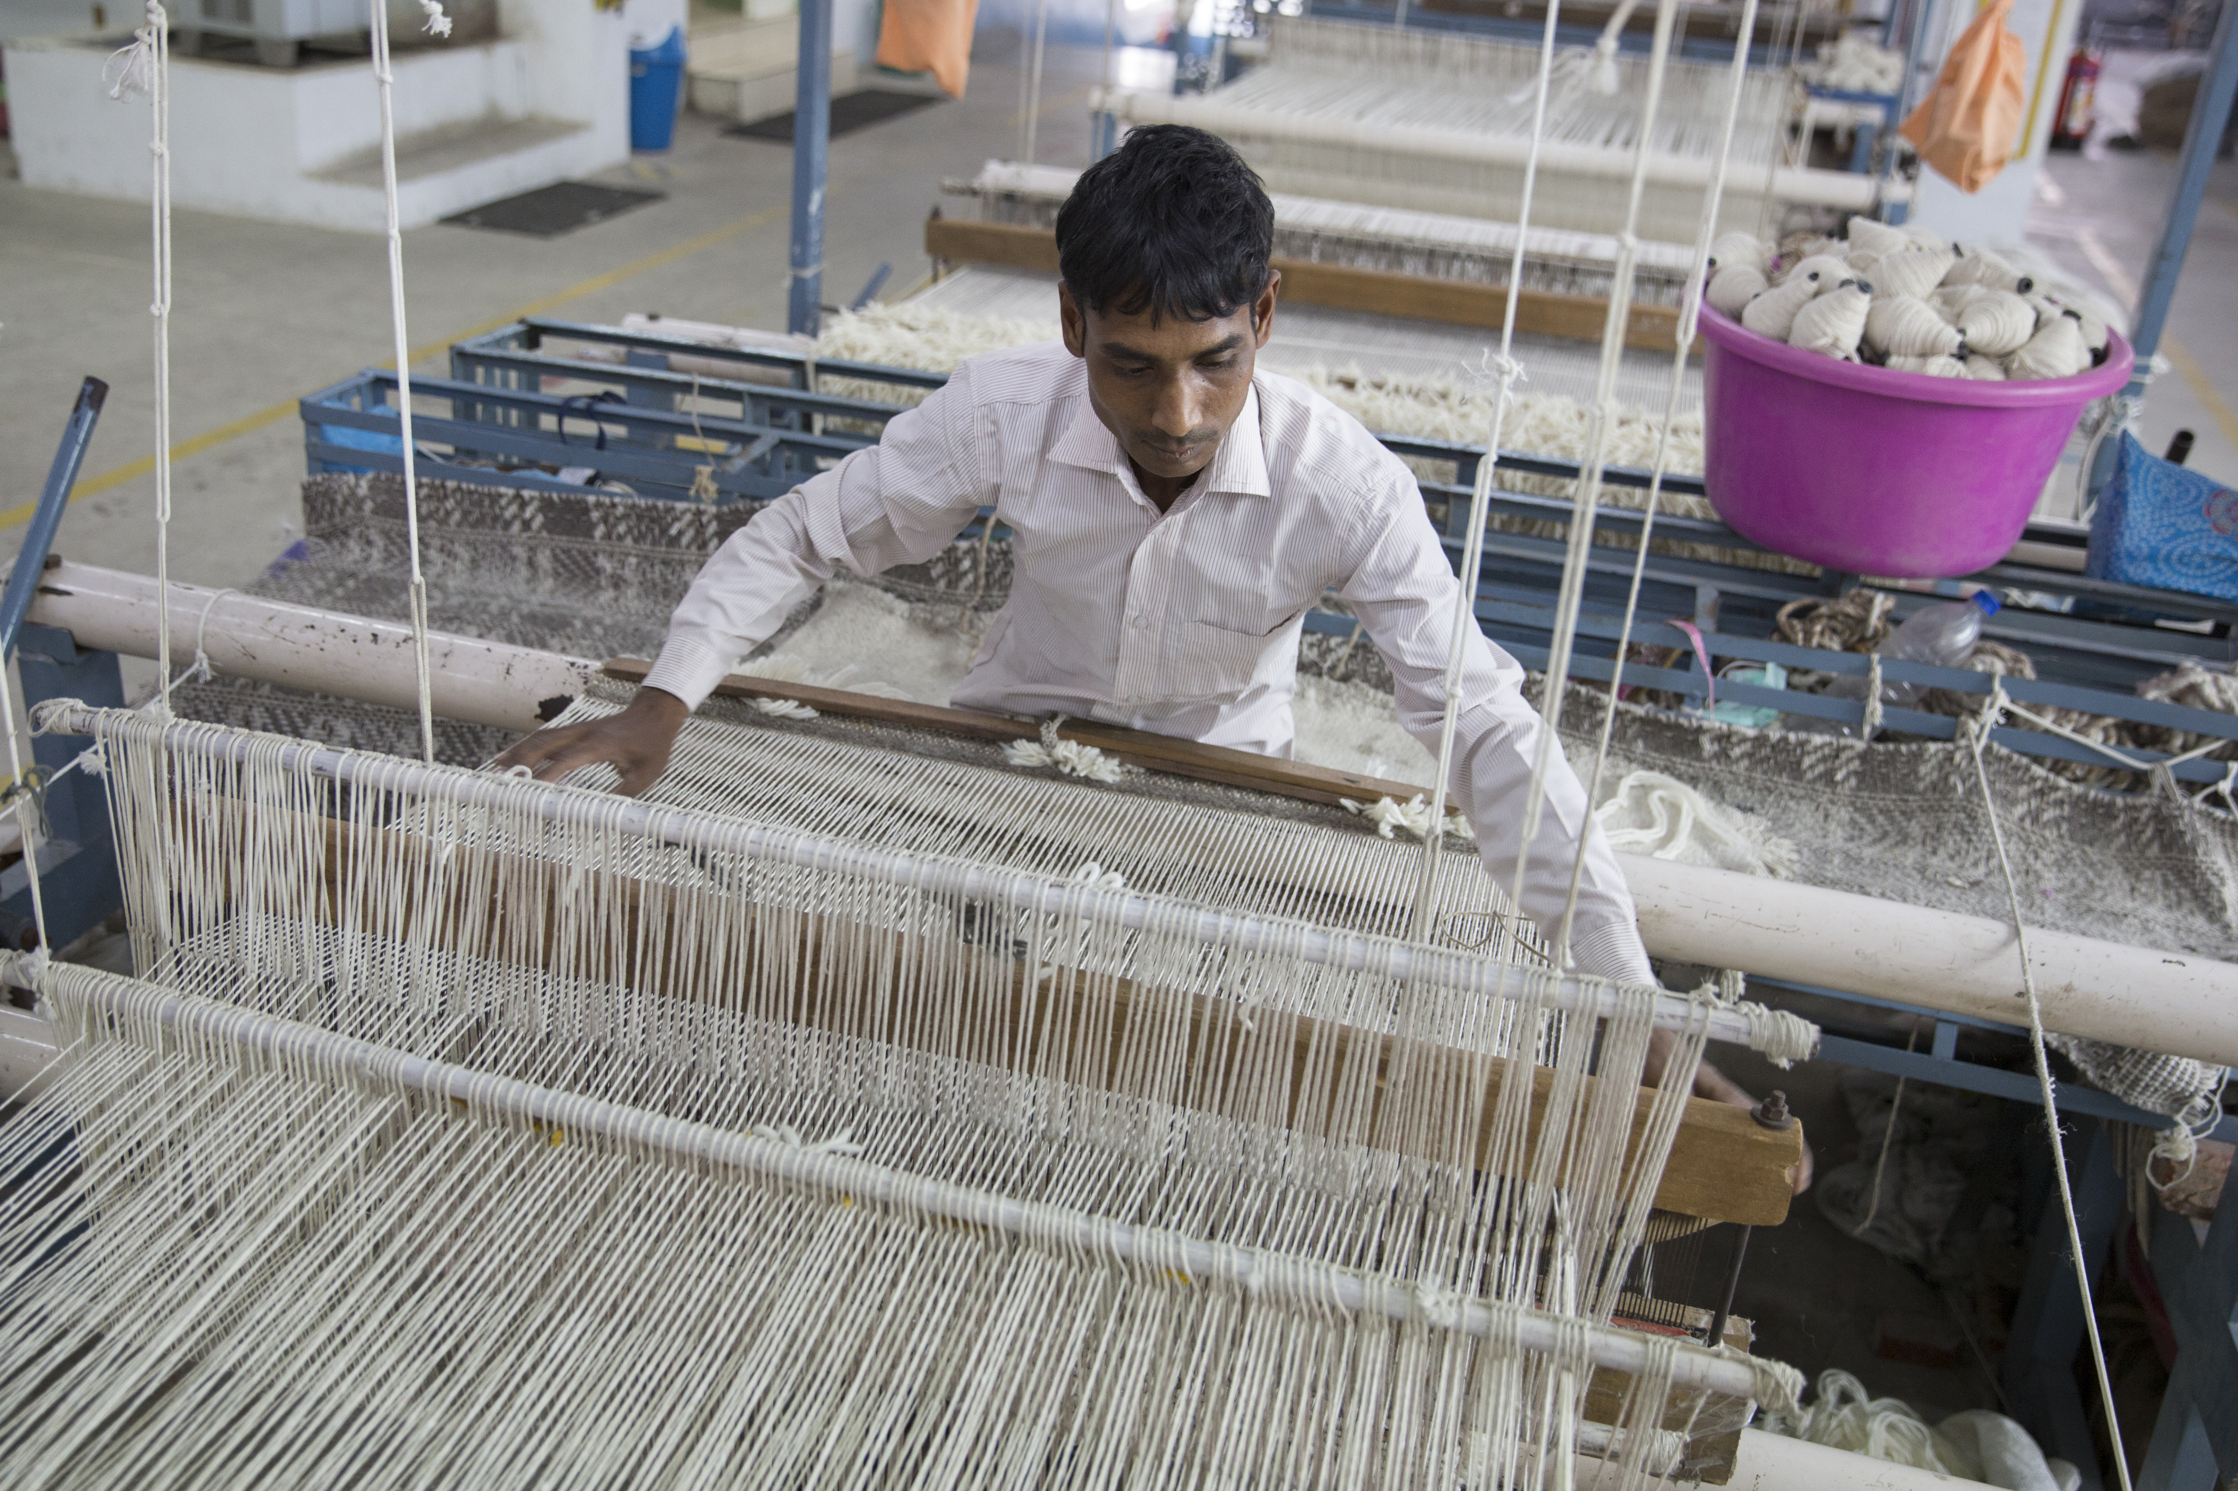
The Need for Fair Trade
The percent of retail cost that a garment worker receives for a product ranges 0.5 – 4%
Bangladesh garment factory collapse
Killed 1,100 workers
U.S. consumers are willing to pay 5% more
for Fair Trade products
Learn More at: www.FairTradeCampaigns.org
Notes:
-It is estimated that the average percentage of the final retail cost of a garment made in the developing world, which goes to the garment worker, ranges from 0.5- 4%.
-In 2013, a Bangladesh garment factory collapsed and killed 1,100 workers – one of the deadliest -industrial tragedies in history.
-In the USA, 57% of consumers surveyed said they were willing to pay at least five percent more for Fair Trade Certified products.

Slide 4
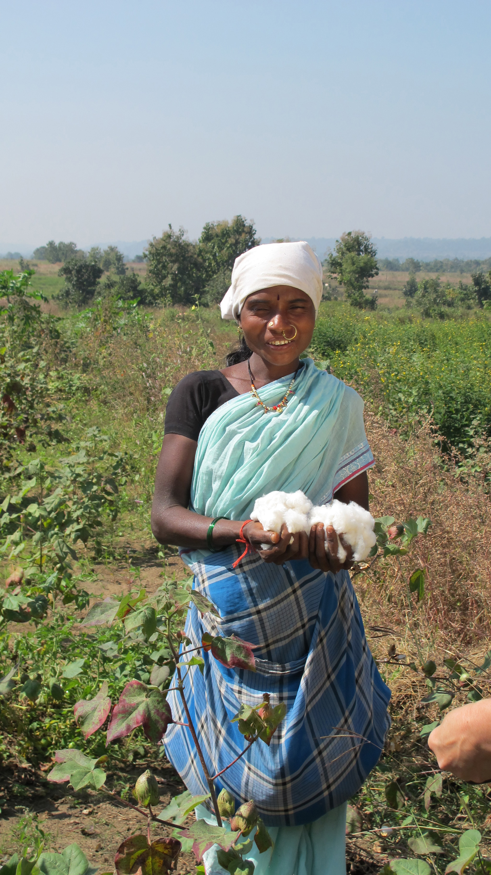
Cotton Farms
Conventional Farms
Environmental impacts
High-pesticide use
Water contamination
Fair Trade Farms
Farmers can earn up
to 30% more
Learn More at: www.FairTradeCampaigns.org
Notes:
Textile production has environmental and health impacts from high-pesticide use in conventional cotton fields, to water contamination from toxic dyes used in fabrics
Fair Trade guarantees competitive prices are received for cotton yields.
Cotton farmers in countries like Mali and India can earn up to 30 percent more on Fair Trade sales through a guaranteed minimum price.

Slide 5
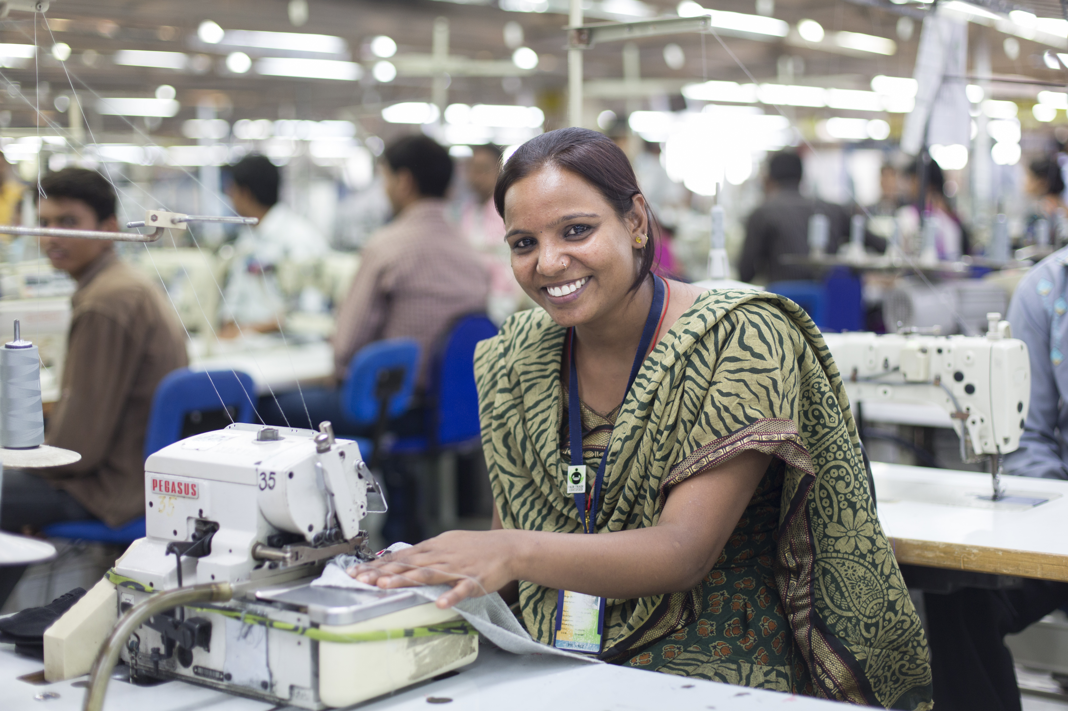
Apparel Factories
Conventional Apparel
Child labor
Low wages
Long hours
Fair Trade Apparel
Earn 15% above local minimum wage
Equal rights for women
Learn More at: www.FairTradeCampaigns.org
Notes:
Child labor and low-wage conditions are common as factories seek to produce in the lowest cost countries.
Factory:
In Fair Trade certified factories, worker satisfaction is high and turnover is low
Workers in certified factories earned 15 percent above local minimum wage on average
Fair Trade standards mandate that women receive equal pay and equal rights as well as maternity leave and freedom from harassment.

Slide 6
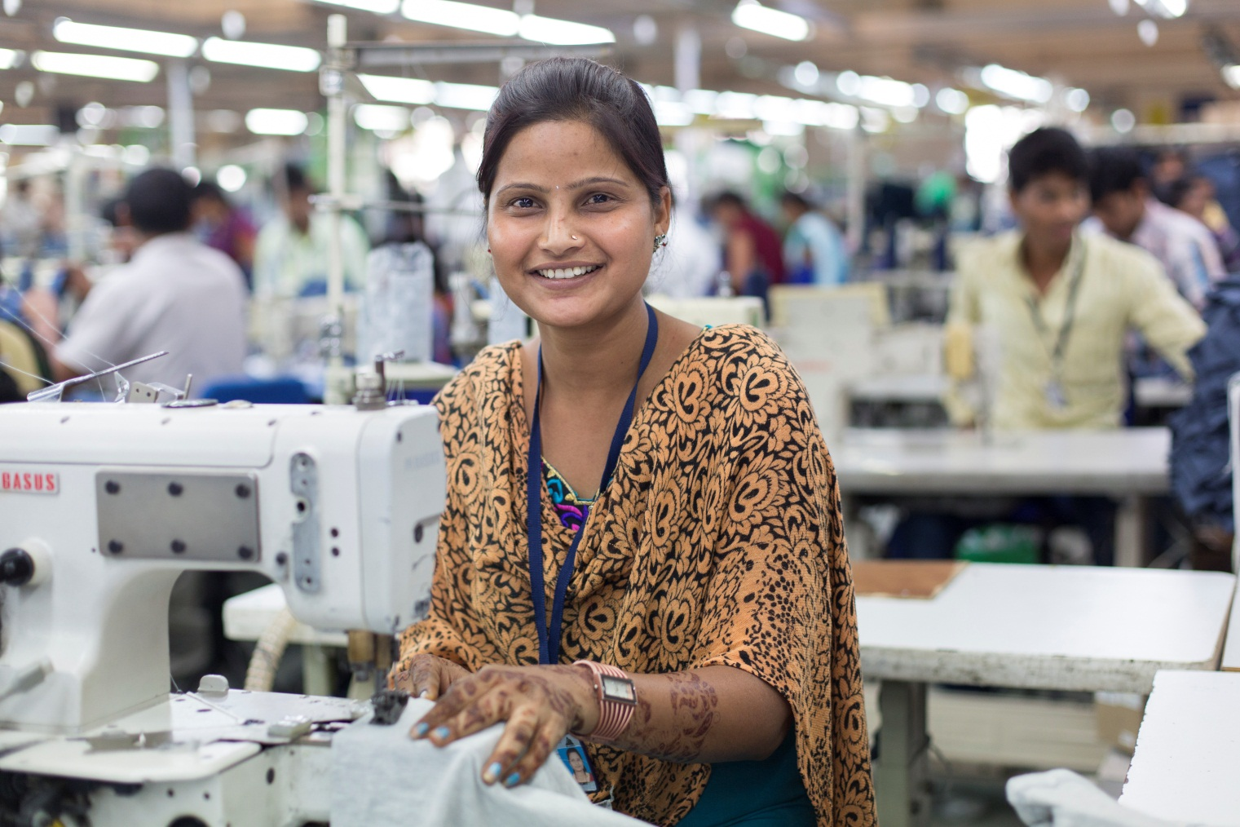
Producer Profile
Notes:
Description:
Alka Nim, 28, from Mahu, Madhya Pradesh, works as a tailor in Pratibha Syntex, in Pithampur, Madhya Pradesh, India. A member of the factory's Fair Trade Committee, she has worked at the factory for 9 years. "I really appreciate all the standards in place that make this a great workplace. Things like air conditioning, water coolers, fixed hours, transportation are not a given at other garment factories. Caste, status and sexual harassment are not a problem here either." Through her involvement in the FT committee, she is proud "to help the workers have a voice and to find ways to improve benefits for our workers." Proposals she wants to forward include issuing raincoats for workers that travel from far (she commutes 30km a day by factory-provided bus) or distributing small gifts during special holidays.

Slide 7
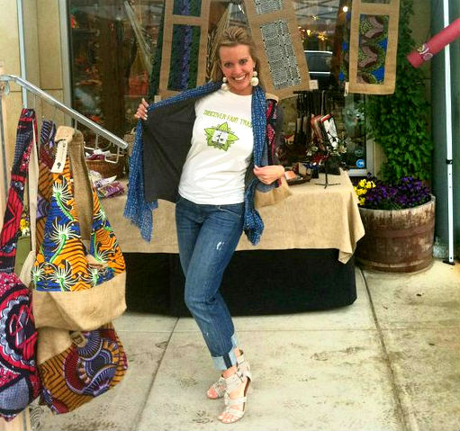
Join the Movement!
Buy Fair Trade Apparel
Volunteer with our campaign
Start a campaign
Towns, Colleges & Universities, Schools, and Congregations
Learn More at: www.FairTradeCampaigns.org

Slide 8
Companies and Products
Good & Fair Clothing
http://www.goodandfairclothing.com
HAE Now
http://www.haenow.com/
Indigenous Designs Corp
http://www.indigenous.com/
Oliberté Footwear
http://www.oliberte.com/
PACT apparel
http://www.wearpact.com/
Patagonia Incorporated
http://www.patagonia.com/
Portico Brand Group
http://www.porticohome.com
prAna
http://www.prana.com/
West Elm
http://www.westelm.com/
Learn More at: www.FairTradeCampaigns.org

Slide 9
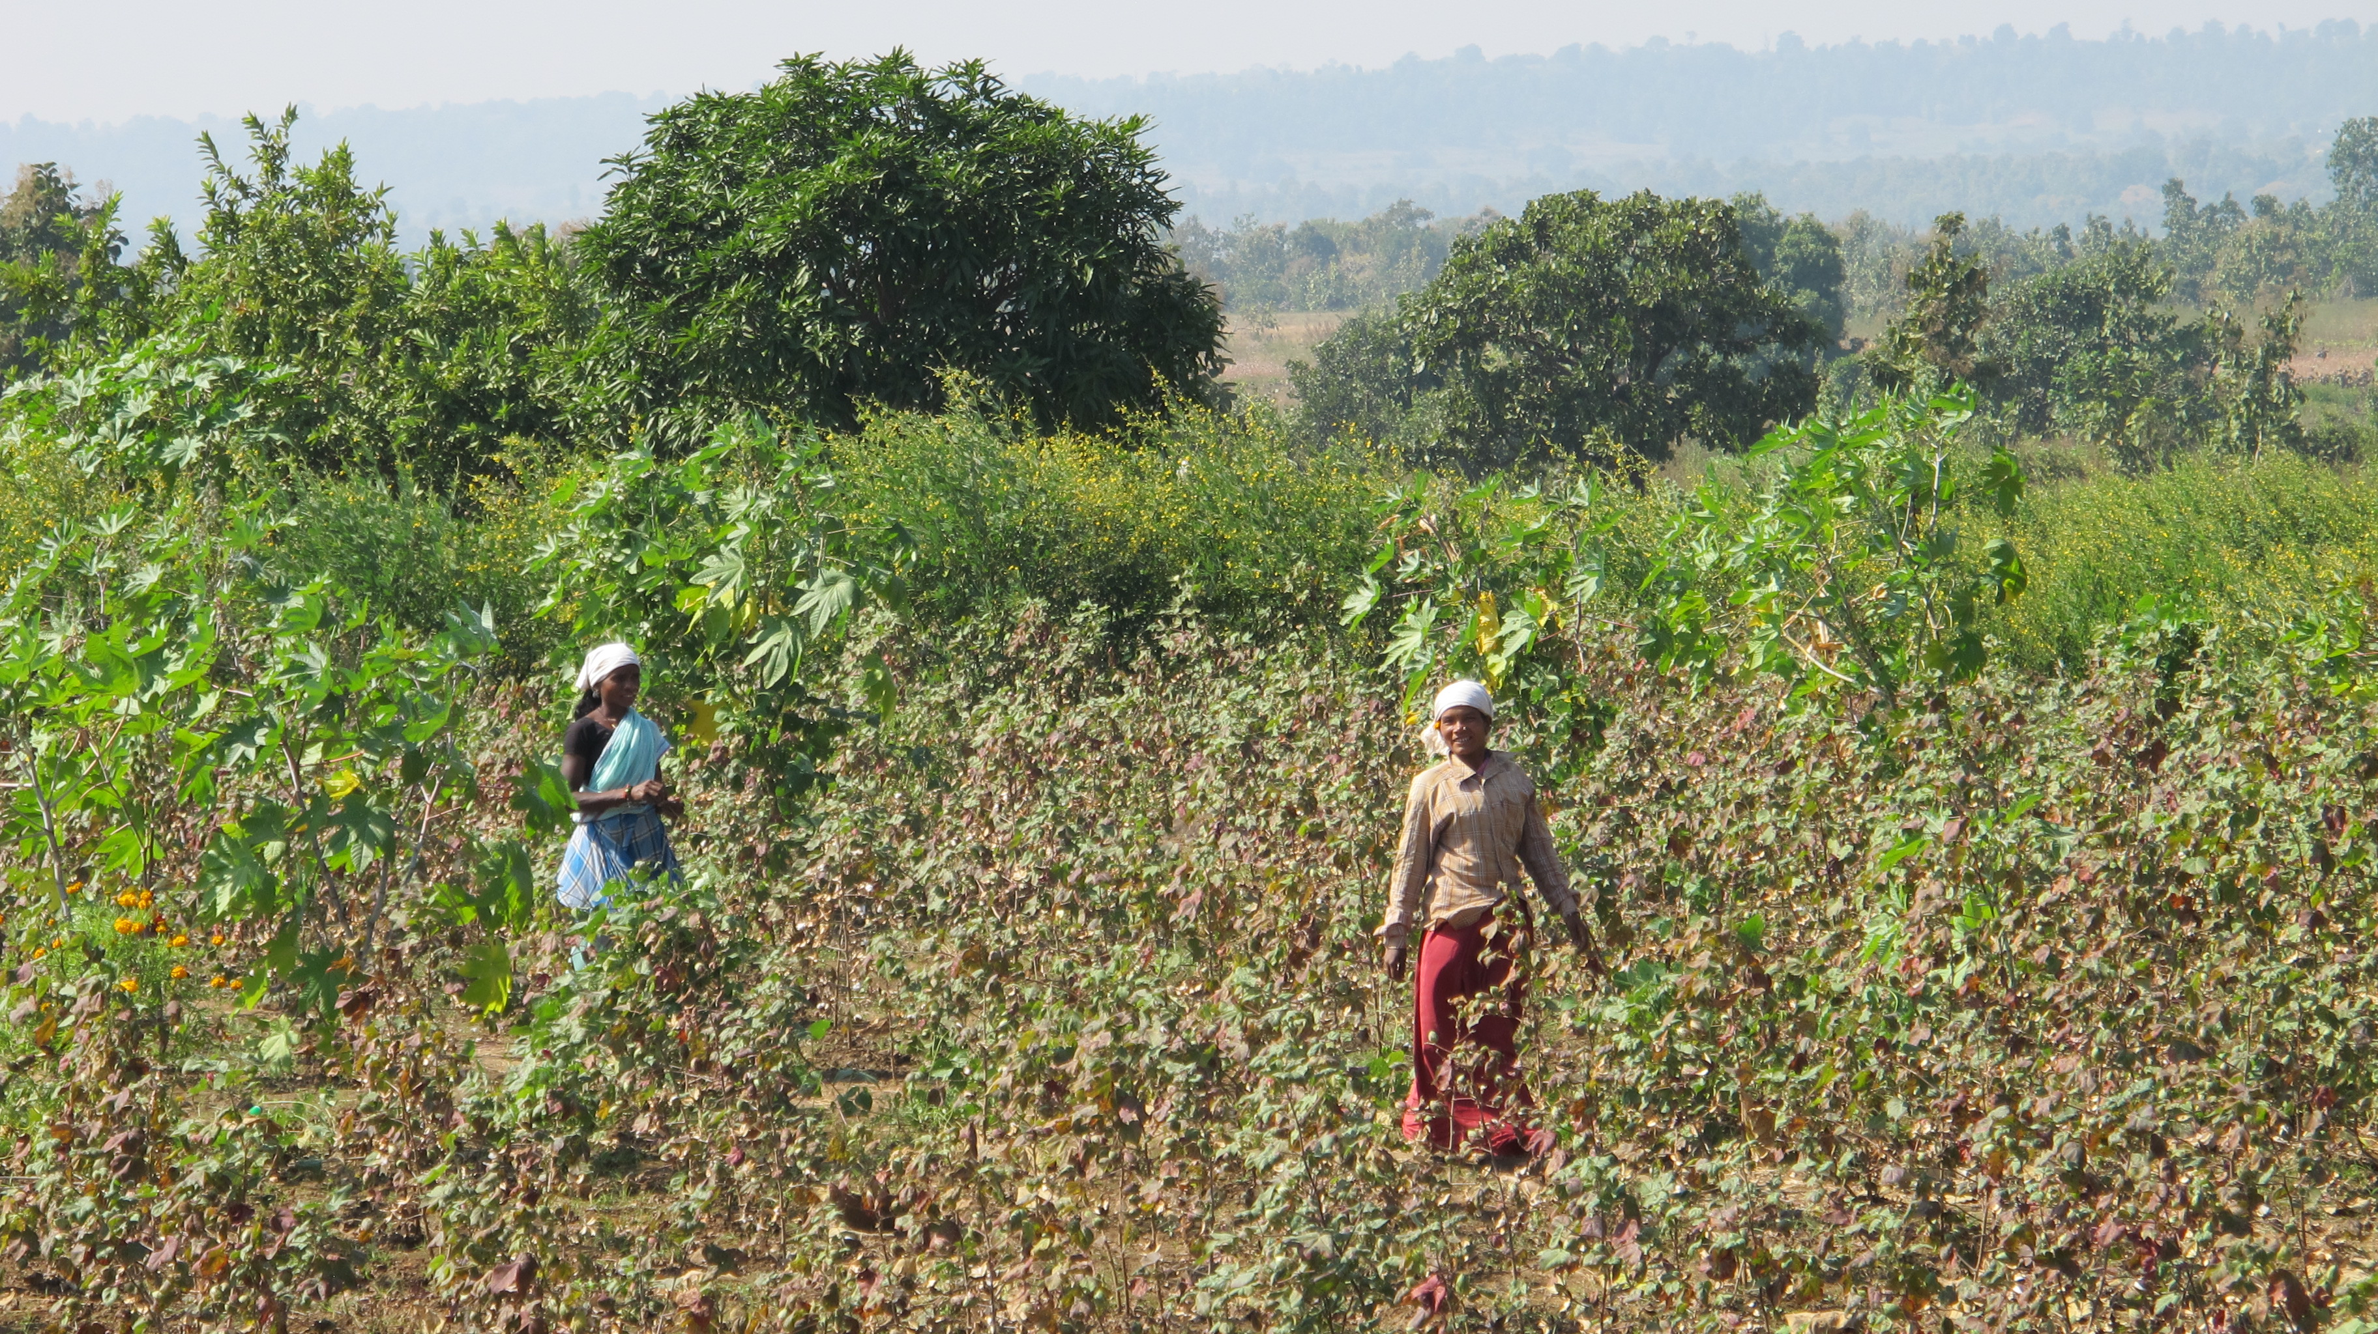
For more information:
Fair Trade USA –
http://fairtradeusa.org/products-partners/apparel
Triple Pundit–
http://www.triplepundit.com/2014/05/change-world-wardrobe-5-things-may-know-fair-trade-apparel/
Ethical Fashion Forum–
http://www.ethicalfashionforum.com/the-issues/wages-workers-rights
Hae Now–
http://www.haenow.com/cart/whyfairtrade.php?osCsid=8mojhigbk20jvcphij77c737b0
Learn More at: www.FairTradeCampaigns.org

