Slide 1
Fair Trade Cocoa
Learn More at: www.FairTradeCampaigns.org

Slide 2
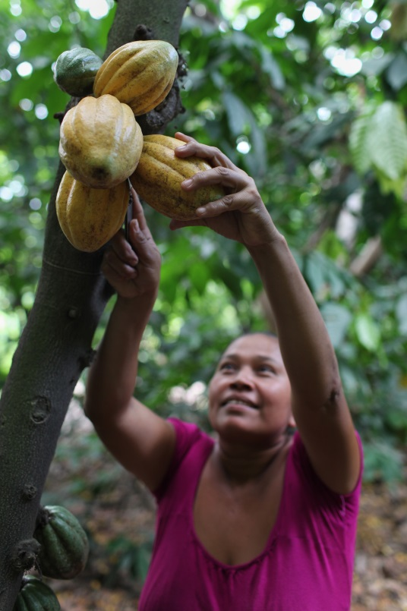
Cocoa Fast Facts
Less than 5% of the world’s cocoa is Fair Trade
African countries produce 73% of all cocoa
Demand for cocoa rises 3% annually
Learn More at: www.FairTradeCampaigns.org
Notes:
SLIDE 2: Cocoa FACTS
1—
2—Over half of this 75% comes from Cote d’Ivoire. The six largest cocoa producing countries are the Ivory Coast, Ghana, Indonesia, Nigeria, Brazil, and Cameroon
3—By 2020, this means that demand will outpace supply

Slide 3
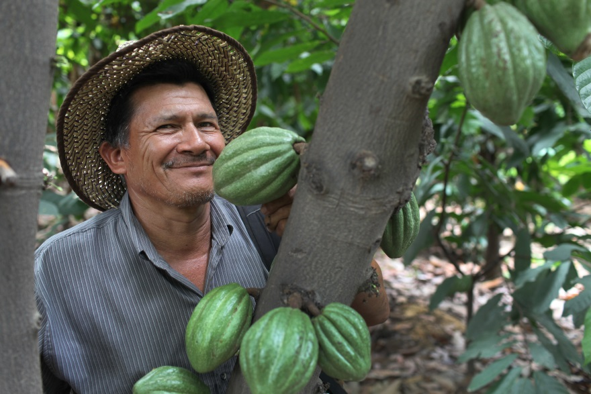
The Need for Fair Trade
Cocoa is a $16 billion a year industry
Average annual revenue for cocoa farmers:
- Between $30 and $110 per household
Learn More at: www.FairTradeCampaigns.org

Slide 4
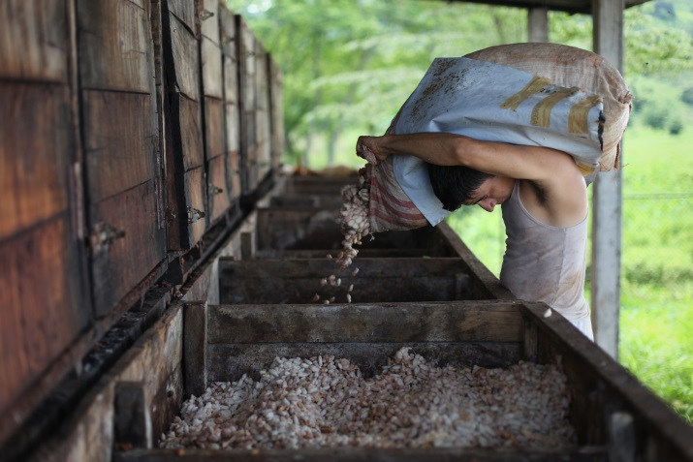
Cocoa and Wages
Conventional Cocoa
Unstable global market prices
Harvests sold to middlemen
Fair Trade Cocoa
Opportunity for investment
Protection of a floor price
Directly improves a farmer’s standard of living
Learn More at: www.FairTradeCampaigns.org
Notes:
Conventional:
- Growers receive between 3.5% - 6.4% of the final value of a chocolate bar containing their cocoa.
Fair Trade:
- Fair Trade Community Development Premium (an additional price paid above the cost of cocoa) ensure producer groups have the opportunity to invest in the future of their farms and communities. These funds are used for programs that are democratically decided upon.
- Protection of a floor price – so producers never have to sell their crop below the price of production
-Since 90% of the world's cocoa is grown on small family farms of 12 acres or less, Fair Trade cocoa is directly improving the standard of living for farmers in the poorest regions of the world.

Slide 5
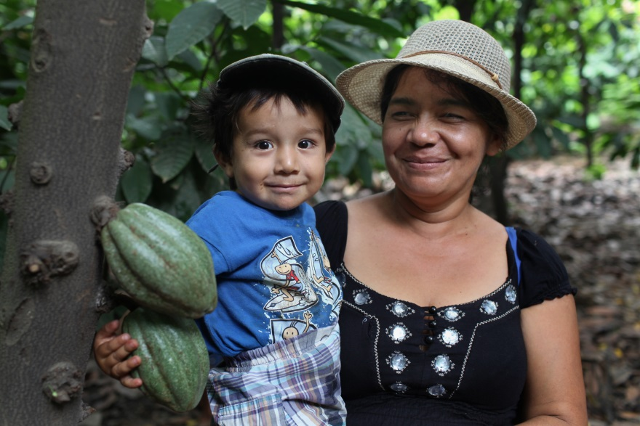
Cocoa and Child Labor
Conventional Cocoa
An estimated 284,000 children work on cocoa farms
Fair Trade Cocoa
Regularly audited
Immediate action
Learn More at: www.FairTradeCampaigns.org
Notes:
Conventional:
-Farmers often use child labor to keep their prices competitive
-Children are exposed to:
Dangerous equipment
Chemicals
Demanding labor
-Unable to attend school
Fair Trade:
-Fair Trade cocoa producers are regularly audited against strict standards that prohibit child labor
-When breaches are found, immediate action takes place to protect the children
-Cocoa from farms found to be using child labor, will not enter the Fair Trade system or lose certification

Slide 6
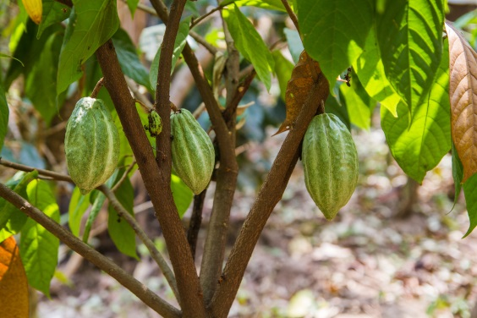
Cocoa and the Environment
Conventional Cocoa
Use of pesticides
Spread of disease
Damages soil
Fair Trade Cocoa
Restricted use of pesticides
Agricultural diversification
Ban GMOs
Learn More at: www.FairTradeCampaigns.org
Notes:
Conventional:
-Farmers use pesticides to keep away bugs and diseases, and fertilizers that make plants grow faster.
-Chemicals make the water and air dirty which then spread disease throughout the communities
-The soil also becomes damaged which makes it difficult for crops to grow
Fair Trade:
-Protects water resources and natural vegetation
-Promotes agricultural diversification (the growing of other types of products on a farm), controls erosion, and forbids slash and burn
-Restricts the use of pesticides and fertilizers
-Bans the use of genetically-modified organisms (GMOs)
-Properly manages waste, water and energy

Slide 7
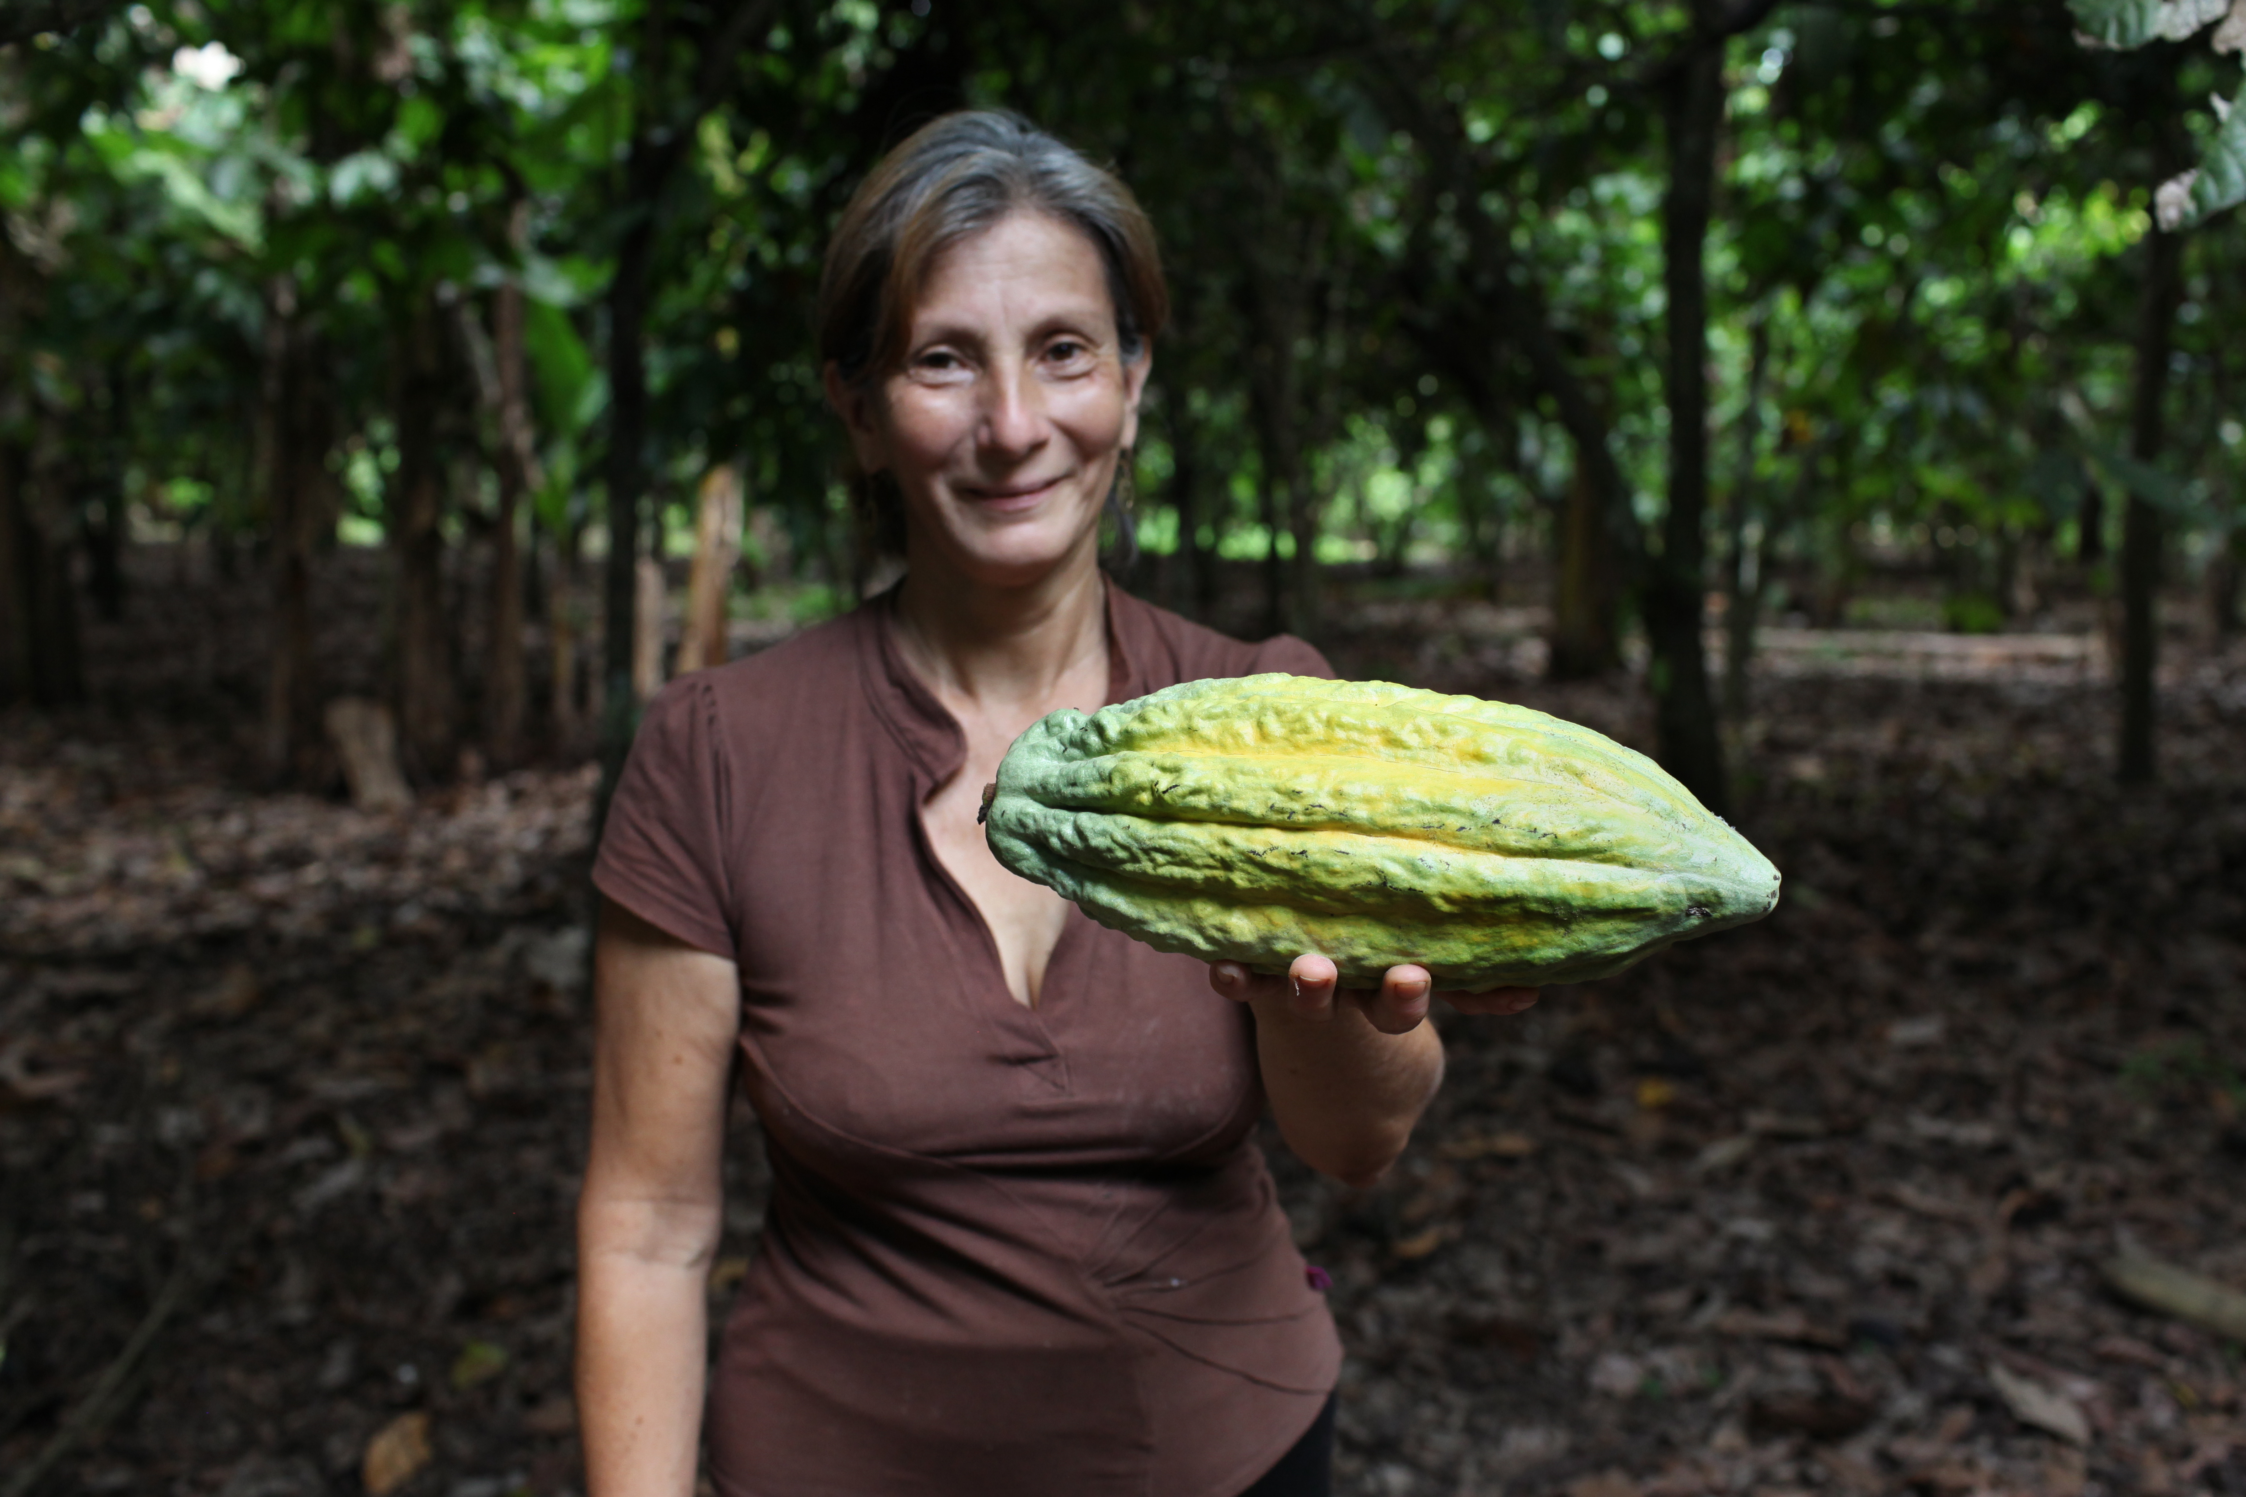
Producer Profile
Notes:
Mariana del Jesus Mendoza (left), 52, cacao grower associated to Fortaleza del Valle since 2006 and currently on the Co-Op's board of directors, holds a recently harvested cacao pod. Mariana declares: "Thanks to Fair Trade we are able to sell our cacao at fair and stable prices. Before we were organized (into Fortaleza del Valle), many of us did not know how to take true advantage of our plants' capacities and would ruin them with pesticides and fungicides." Fortaleza del Valle: Canuto, Chone, Manabi, Ecuador. February 22, 2013.

Slide 8
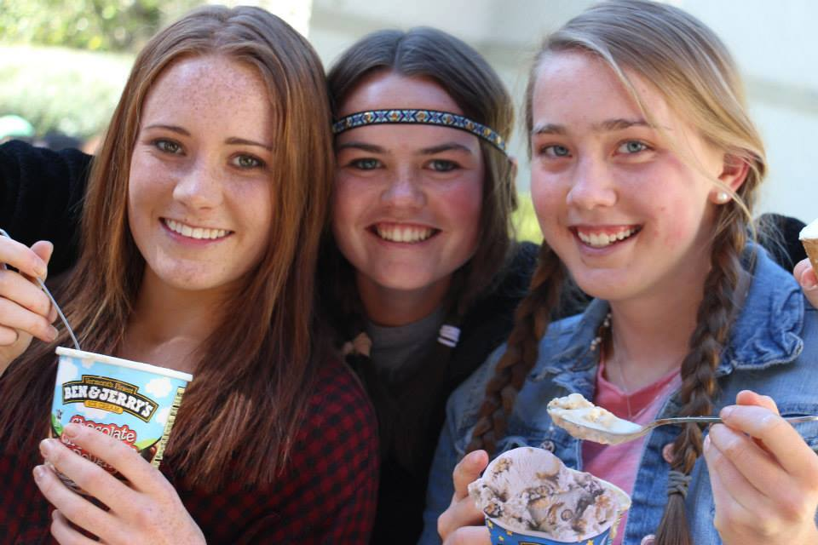
Join the Movement!
Buy Fair Trade Cocoa
Volunteer with our campaign
Start a campaign
Towns, Colleges & Universities, Schools, and Congregations
Learn More at: www.FairTradeCampaigns.org

Slide 9
Cocoa Companies
Alter Eco Americas
ARTISAN COCOA Incorporated
Bake One Inc
Barefoot & Chocolate LLC
Chocolate Alchemy
Chocolove
Coco – Zen
Equal Exchange
Guittard Chocolate Company
Lake Champlain Chocolates
Lara Bar
Natural Nectar
Proud Harvest Inc
Pura Vida Coffee Company
Salazon Chocolate Company LLC
Seely Family Farm Incorporated
Shaman Chocolates
Sjaak's Organic Chocolates
Spectrum
SRSLY chocolate Incorporated
Stacy's
SunRidge Farms
Sunspire Chocolates
Sweetriot
The Good Bean LLC
Travel Chocolate LLC
UnReal Brands
World's Finest Chocolates
Learn More at: www.FairTradeCampaigns.org

Slide 10
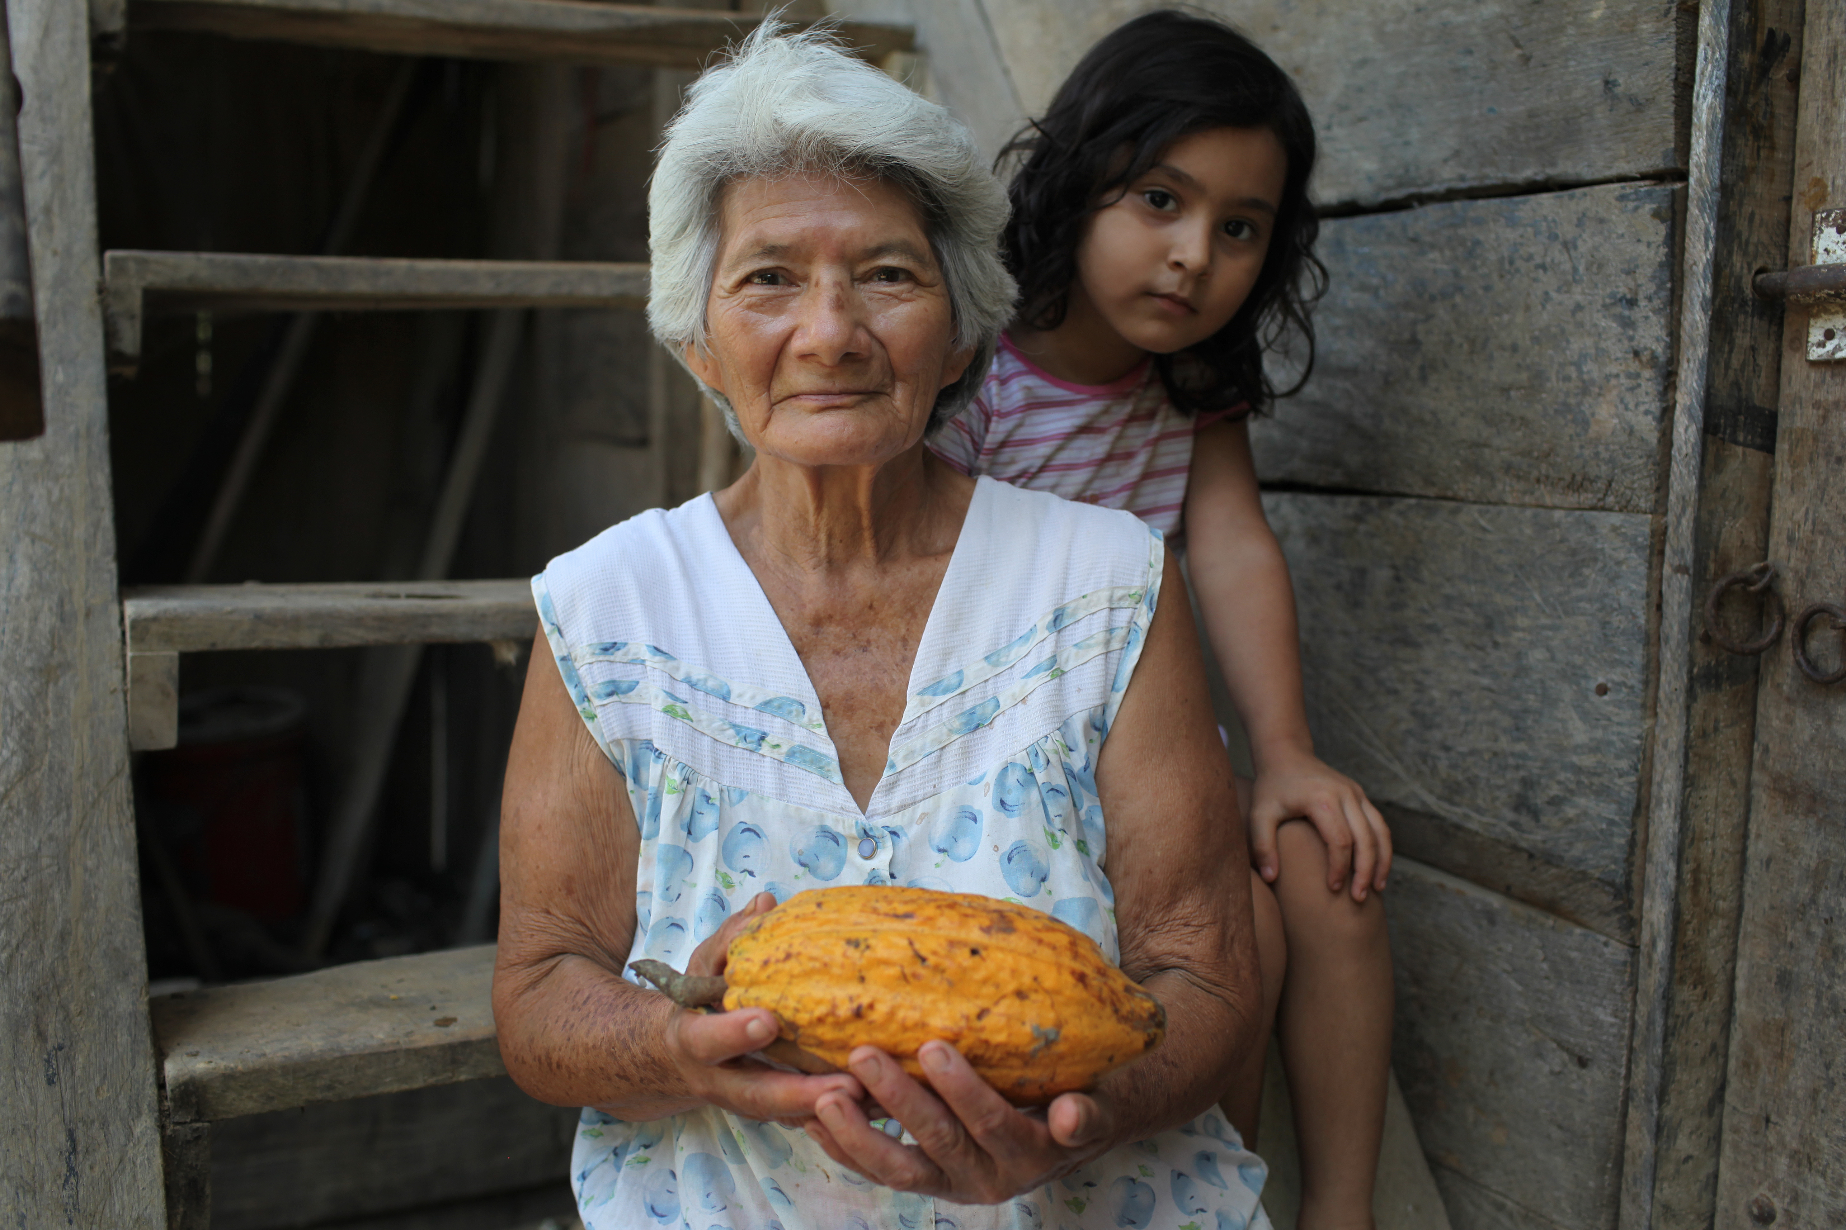
For more information:
Fair Trade USA –
http://fairtradeusa.org/sites/default/files/FT_FAQ_Cocoa.pdf
Fairtrade International –
http://www.fairtrade.net/cocoa.html
Global Exchange –
http://www.globalexchange.org/fairtrade/campaigns/cocoa
Green America –
http://www.greenamerica.org/programs/fairtrade/products/chocolate.cfm
Make Chocolate Fair –
http://makechocolatefair.org/
Learn More at: www.FairTradeCampaigns.org

