Slide 1
Back to School Organizing 101
September 9th, 2015

Slide 2
Housekeeping
Please follow these instructions to participate:
1) You MUST dial-in to the conference line to hear audio:
Number: 1-866-939-8416, Access code: 3200618#
2) Put yourself on mute on your phone at all times except if you have a question during Q&A. Press *6 to mute yourself and *6 to unmute.
3) Please hold questions until the end when we will have time for Q&A. You can either ask on the phone or type your questions into the Q&A box on the webinar screen and the presenter will read them for you.

Slide 3
Agenda for this Training
Introduction of topic and presenters
Sustainable Leadership Best Practices
Case Study: Villanova University
Top Resources
Fair Trade Month 2015
How to Register Events Online
Q&A

Slide 4
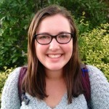
Today’s Presenters
Kylie Nealis
National Organizer, Fair Trade
Colleges & Universities (FTCU)
Courtney Lang
National Organizer,
Fair Trade Towns
Emily Wilson
Fair Trade Colleges & Universities
2014-15 Fellow

Slide 5
Sustainable Leadership
Best Practice #1 – Power Mapping
Power Mapping is a process of identifying who your allies on campus are and who the key decision-makers on your campus are.
Important things to consider:
Start with who you know. Consider which people and networks you already know. Look at existing relationships that your fellows students and lead faculty member have.
Create a list or draw a map to see where there’s connections to your campaign’s goals.
Begin outreach to the people and networks that you already know, gauge their interest.
Look ‘outside the box’, connect your Fair Trade efforts on campus to other sustainability and social justice efforts on campus.

Slide 6
Sustainable Leadership
Best Practice #2 – Engagement & Recruitment
Engaging and recruiting campaign leaders is essential to the long-term effectiveness of the campaign.
Important things to consider:
Articulate the WIFM [what’s in it for me] – team members should connect with the mission of Fair Trade but also see how they can personally benefit. For example: valuable community organizing experience, resume building, networking, potential benefits to their academic studies, study abroad or immersion opportunities, etc.
Networking – it’s important to network, attend various events on campus and engage your fellow students in conversations about Fair Trade and your campaign. The key to engaging and recruiting new leaders is getting them passionate about Fair Trade!

Slide 7
Sustainable Leadership
Best Practice #3 – Anticipating & Dealing with Turnover
Turnover, or the task of replacing yourself, is something that every campaign faces. Luckily, by utilizing some of these tips, you can anticipate and plan for it without your campaign missing a beat!
Important things to consider:
Clear communication: make sure that the people involved in your campaign clearly articulate their plans for the future and their commitment to leading the campaign.
Advance notice: organizers leave campaigns for many reasons (graduation, study abroad, etc.) Give your campaign at least three months notice beforehand and establish this as an expectation.
Mentoring: mentor and recruit underclassmen early on to replace campaign leaders.

Slide 8
Case Study: Villanova University

Slide 9
Top Campaign Resources
Fair Trade Campaigns has a long list of resources to help your campus become a declared Fair Trade College University or School.
Here are a few of the top resources that we recommend:
1) Student Action Guide:
http://fairtradecampaigns.org/resource/student-action-guide/
2) Fair Trade Products 101:
http://fairtradecampaigns.org/resource/fair-trade-product-list/
3) Fair Trade & Environmental Sustainability:
http://fairtradecampaigns.org/resource/fair-trade-and-environmental-sustainability/

Slide 10
WEEKLY THEMES
Week 1 - Fair Trade in Action!
Week 2 – Why Choose Fair?
Week 3 – Fair Trade Cuties
Week 4– Best Overall Photo
PRIZES
First 3 weeks: 3 gift baskets full of Fair Trade goodies! From Ben & Jerry’s gift cards to PACT clothing to Guayaki Tea and more!
Grand prize: Travel to Mexico to meet Fair Trade producers!
http://fairtradecampaigns.org/events/fair-trade-photofest-2015/

Slide 11
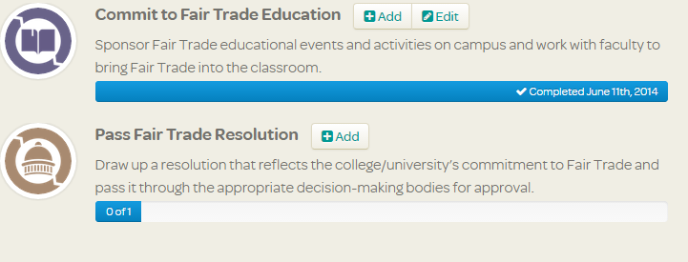
How to Register Events Online
Each time you plan an event, you should register it on the FT Campaigns website. Here’s how in three easy steps:
Go to www.fairtradecampaigns.org, log-in and click ‘Your Campaign’
Next to ‘Commit to Fair Trade Education’, click on ‘add’
Add your event!

Slide 12
Want more Information?
Kylie Nealis – National Organizer, FTCU
knealis@fairtradeusa.org
Courtney Lang – National Organizer, Fair Trade Towns
clang@fairtradeusa.org
Emily Wilson – 2014-15 FTCU Fellow
ewilson@fairtradeusa.org
http://fairtradecampaigns.org/organize/#universities

Slide 13
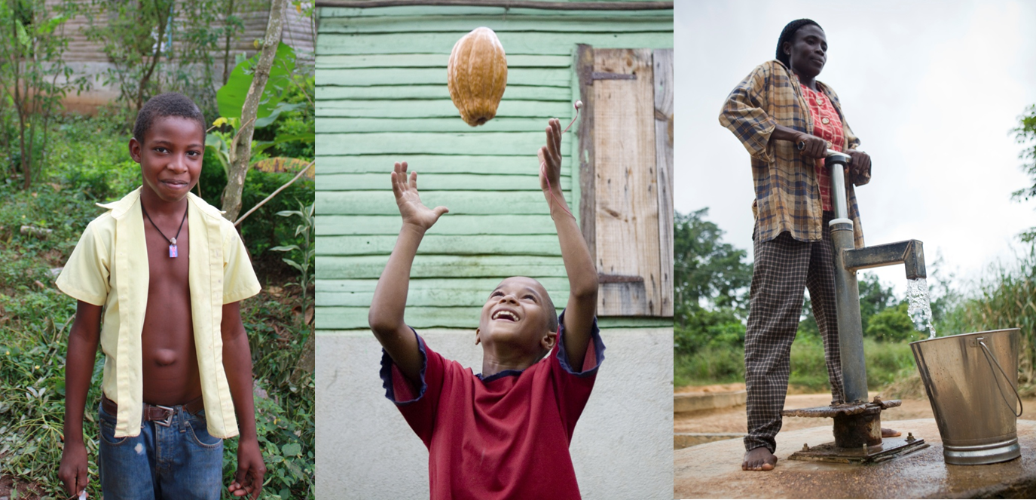
Questions?
“Fair Trade is very important for us. It has helped our community and family, and we have better infrastructure. It has validated growers and our products. Our way of life has changed for the best.”
– Ramon Figueroa, CONACADO, Dominican Republic

