Slide 1
Back to School Organizing 101
September 23, 2015

Slide 2
Housekeeping
Please follow these instructions to participate:
1) You MUST dial-in to the conference line to hear audio:
Number: 1-866-939-8416, Access code: 3200618#
2) Put yourself on mute on your phone at all times except if you have a question during Q&A. Press *6 to mute yourself and *6 to unmute.
3) Please hold questions until the end when we will have time for Q&A. You can either ask on the phone or type your questions into the Q&A box on the webinar screen and the presenter will read them for you.

Slide 3
Agenda for this Training
Introduction of topic and presenters
Best Practices: Setting Goals, Objectives & Timelines
Case Study: SUNY Geneseo
Top Resources
Fair Trade Month 2015
How to Register Events Online
Q&A

Slide 4
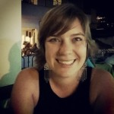
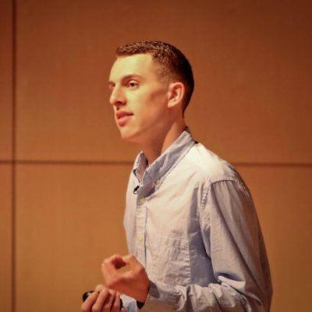
Today’s Presenters
Kylie Nealis
National Organizer, Fair Trade
Colleges & Universities (FTCU)
Anna Juchau
Marketing Campaign Assistant
Fair Trade Campaigns
Ben Conard
Student Chair, FTCU National Steering Committee
Organizer, SUNY Geneseo Fair Trade

Slide 5
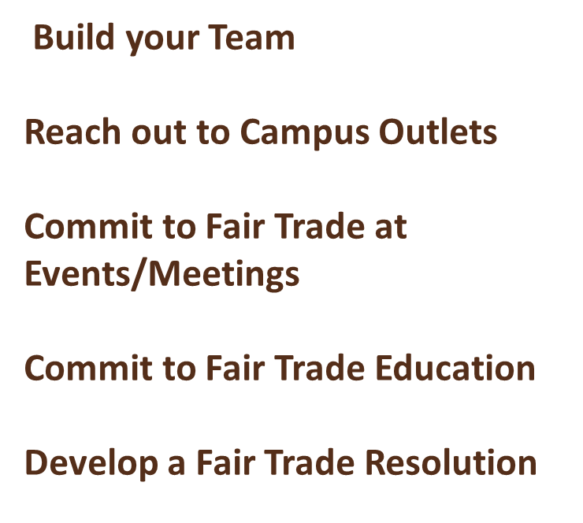
Setting Goals & Objectives
What are the Five Goals to becoming a Fair Trade University?

Slide 6
Setting Goals & Objectives
Tip #1: Different goals require different timelines
Not all five goals to becoming a declared FT School or University can be achieved in the same timeframe, most are on-going.
Important things to consider:
Goal # 1 (Build Your Team) and # 5 (Pass a Fair Trade Resolution) can usually be achieved in one semester whereas Goals # 2 – 4 are on-going. That said, maintaining active, sustainable leadership is an on-going effort for campaigns.
Timelines differ campus to campus – i.e. large, public universities may take 2-3 years to declare whereas a small, private university may only take 1-2 years.

Slide 7
Setting Goals & Objectives
Tip #2: Different goals require different approaches
Since each goal is different, different approaches are required for success. Don’t be afraid to change your approach if it’s not working.
Important things to consider:
Start with a small ask, never be afraid to make an ask and always have support behind you.
Nothing will change in one day – “Rome wasn’t built in a day”.
Be prepared i.e. compile info & resources for stakeholders on campus in advance.
Apply firm but gentle pressure and keep it positive.
Incorporate your campaign into campus events wherever you can, don’t limit yourself.

Slide 8
Setting Goals & Objectives
Tip #3 – Educate, educate, educate
Education is the key to any Fair Trade campaign and is a necessary component to achieving each of the goals.
Important things to consider:
Educate the campus community -- if people understand and are passionate about Fair Trade, they’ll be more likely to support your campaign.
Educate campus decision-makers – campus administration officials are unlikely to support something that they don’t have a solid understanding of. It’s important to ensure that decision-makers know what Fair Trade is and why it’s important.

Slide 9
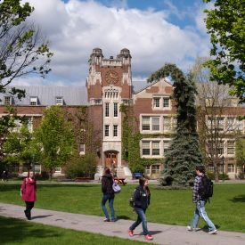
Case Study: SUNY Geneseo

Slide 10
Info & Resources
Student Action Guide:
http://fairtradecampaigns.org/resource/student-action-guide/
Fair Trade Products 101:
http://fairtradecampaigns.org/resource/fair-trade-product-list/
Sustainable Leadership 101:
http://fairtradecampaigns.org/resource/sustainable-leadership-101/
FT Universities:
http://fairtradecampaigns.org/organize/#universities
FT Month:
http://fairtradecampaigns.org/events/fair-trade-photofest-2015/
More Resources: http://fairtradecampaigns.org/resources

Slide 11
October 1st – 31st
WEEKLY THEMES
Week 1 - Fair Trade in Action!
Week 2 – Why Choose Fair?
Week 3 – Fair Trade Cuties
Week 4– Best Overall Photo
PRIZES
First 3 weeks: 3 gift baskets full of Fair Trade goodies! From Ben & Jerry’s gift cards to PACT clothing to Guayaki Tea and more!
Grand prize: Travel to Mexico to meet Fair Trade producers!
http://fairtradecampaigns.org/events/fair-trade-photofest-2015/

Slide 12
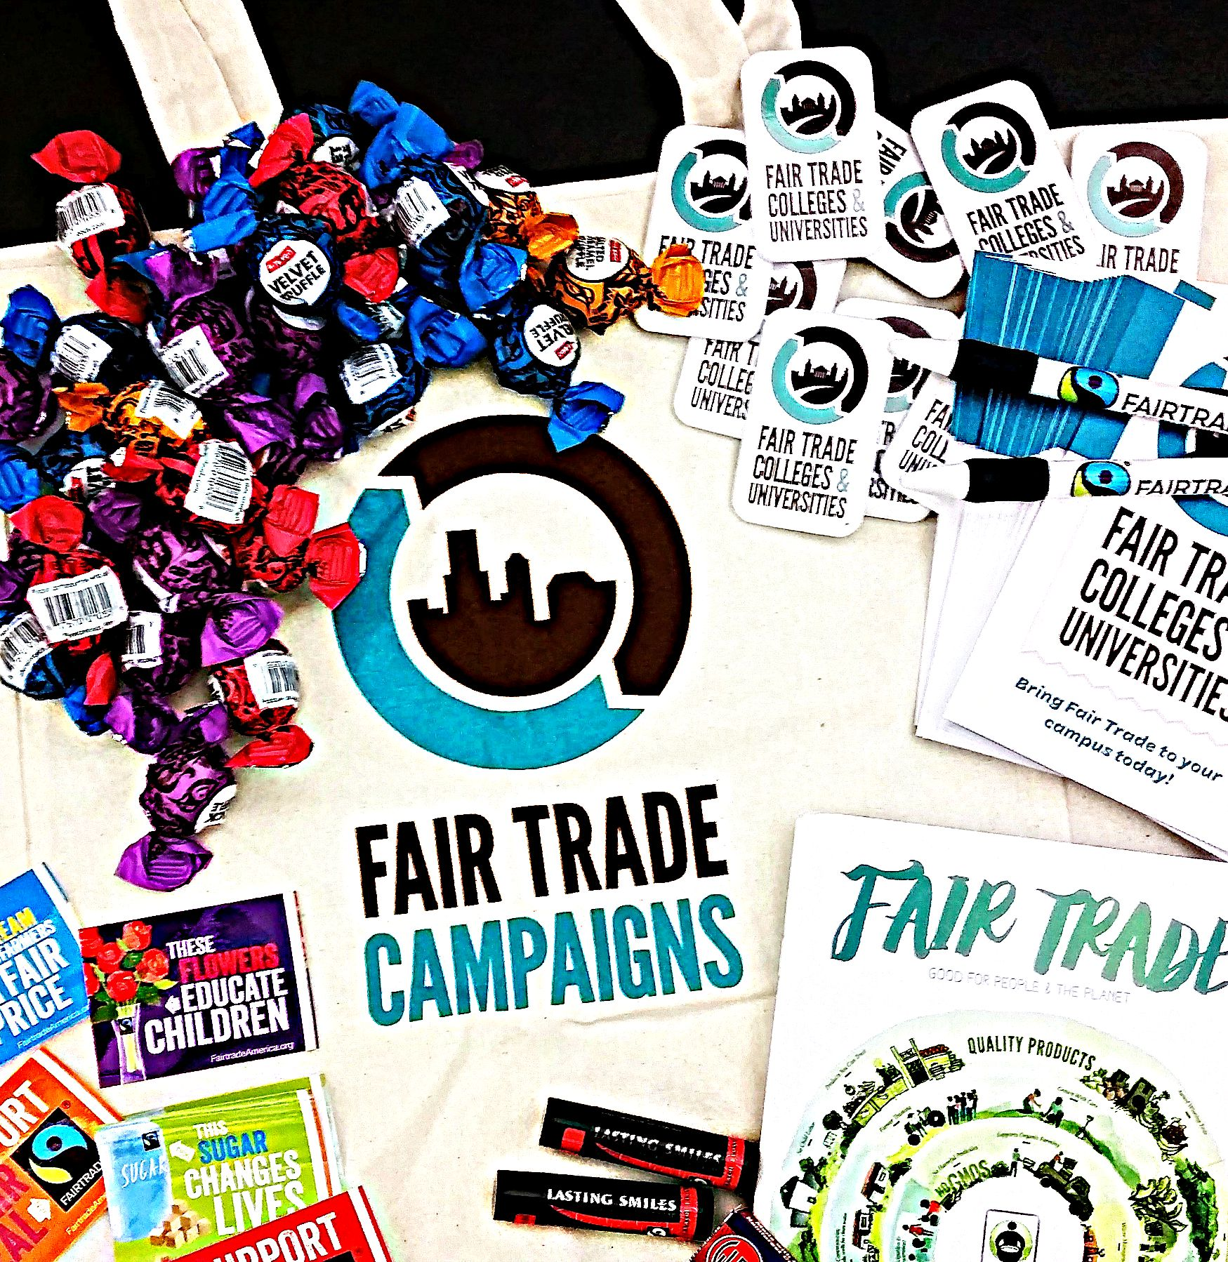
Get Your Back-to-School Event Package!

Slide 13
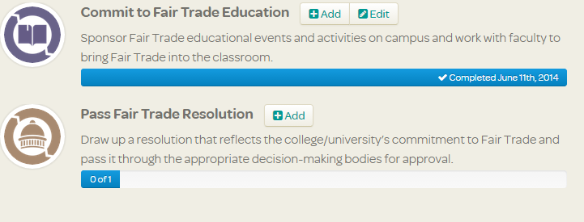
How to Register Events Online
Each time you plan an event, you should register it on the FT Campaigns website. Here’s how in three easy steps:
Go to www.fairtradecampaigns.org, log-in and click ‘Your Campaign’
Next to ‘Commit to Fair Trade Education’, click on ‘add’
Add your event!

Slide 14
Want more Information?
Kylie Nealis – National Organizer, FTCU
knealis@fairtradeusa.org
Ben Conard – Student Co-chair, FTCU Natl’ Steering Committee
blc12@geneseo.edu
FT Universities:
http://fairtradecampaigns.org/organize/#universities
FT Month:
http://fairtradecampaigns.org/events/fair-trade-photofest-2015/
Resources:
http://fairtradecampaigns.org/resources

Slide 15
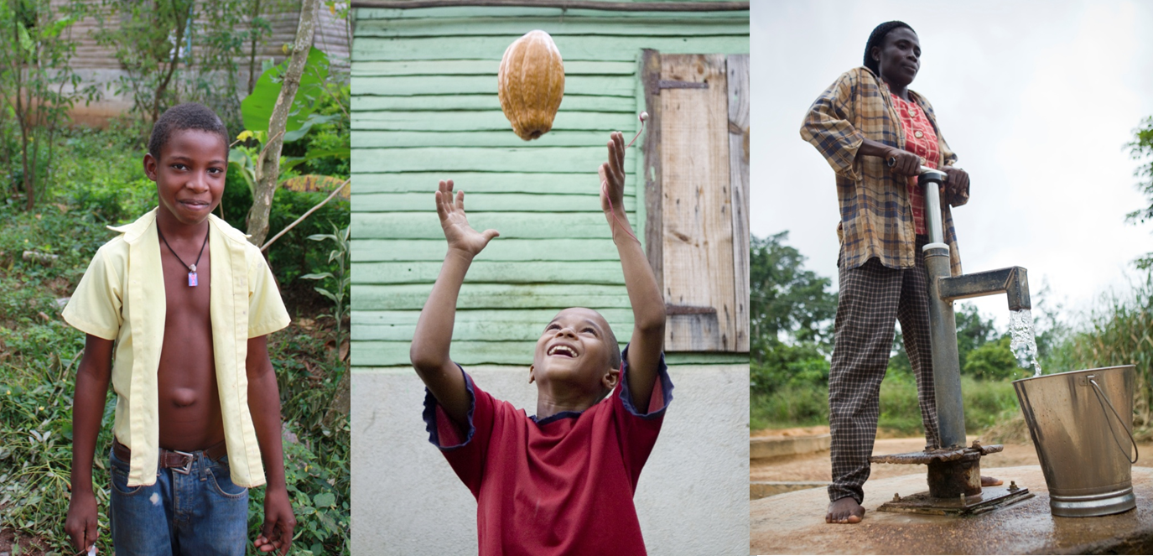
Questions?
“Fair Trade is very important for us. It has helped our community and family, and we have better infrastructure. It has validated growers and our products. Our way of life has changed for the best.”
– Ramon Figueroa, CONACADO, Dominican Republic

