Slide 1
Southern CA Regional Conference September 10th, 2016

Slide 2
Collaboration Best Practices:
Keys to Success
Laurel Averill, Fair Trade LA Boutique Coordinator
Rosalie Plofchan, Fair Trade Campaigns Fellow
www.fairtradecampaigns.org

Slide 3
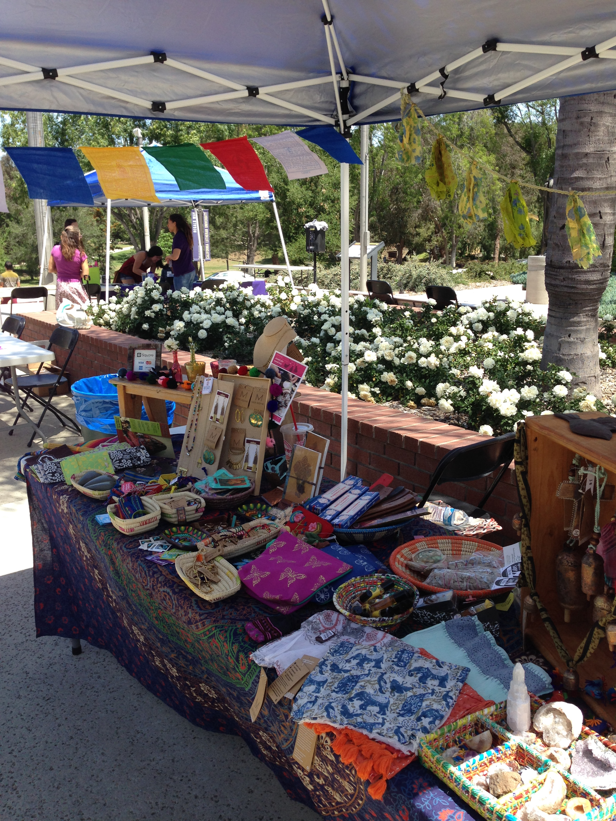
Example 1:
Fair Trade LA Boutiques
www.fairtradecampaigns.org

Slide 4
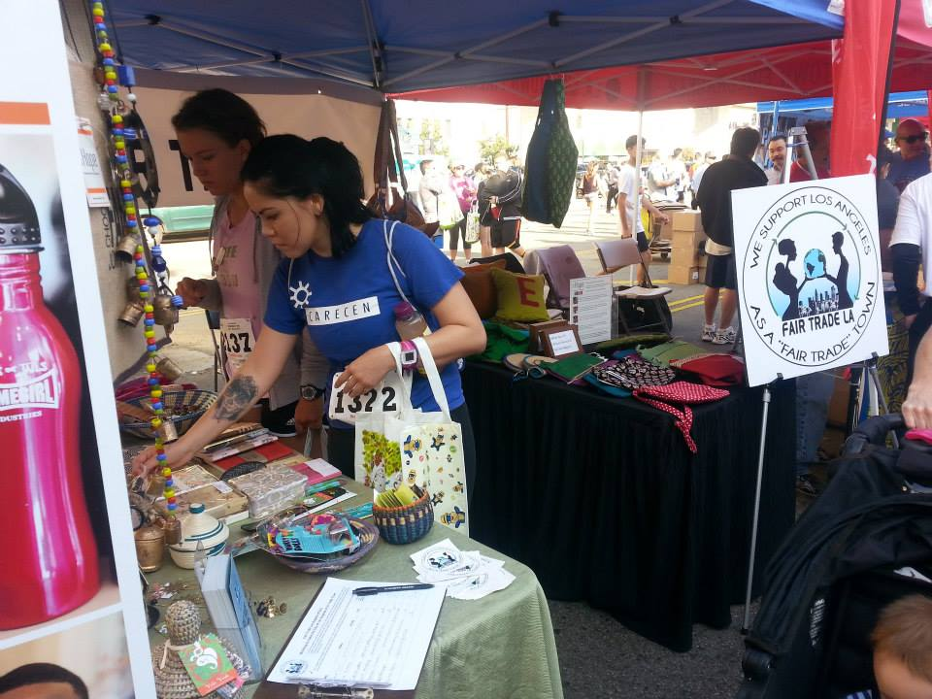
Fair Trade LA Boutiques
www.fairtradecampaigns.org

Slide 5
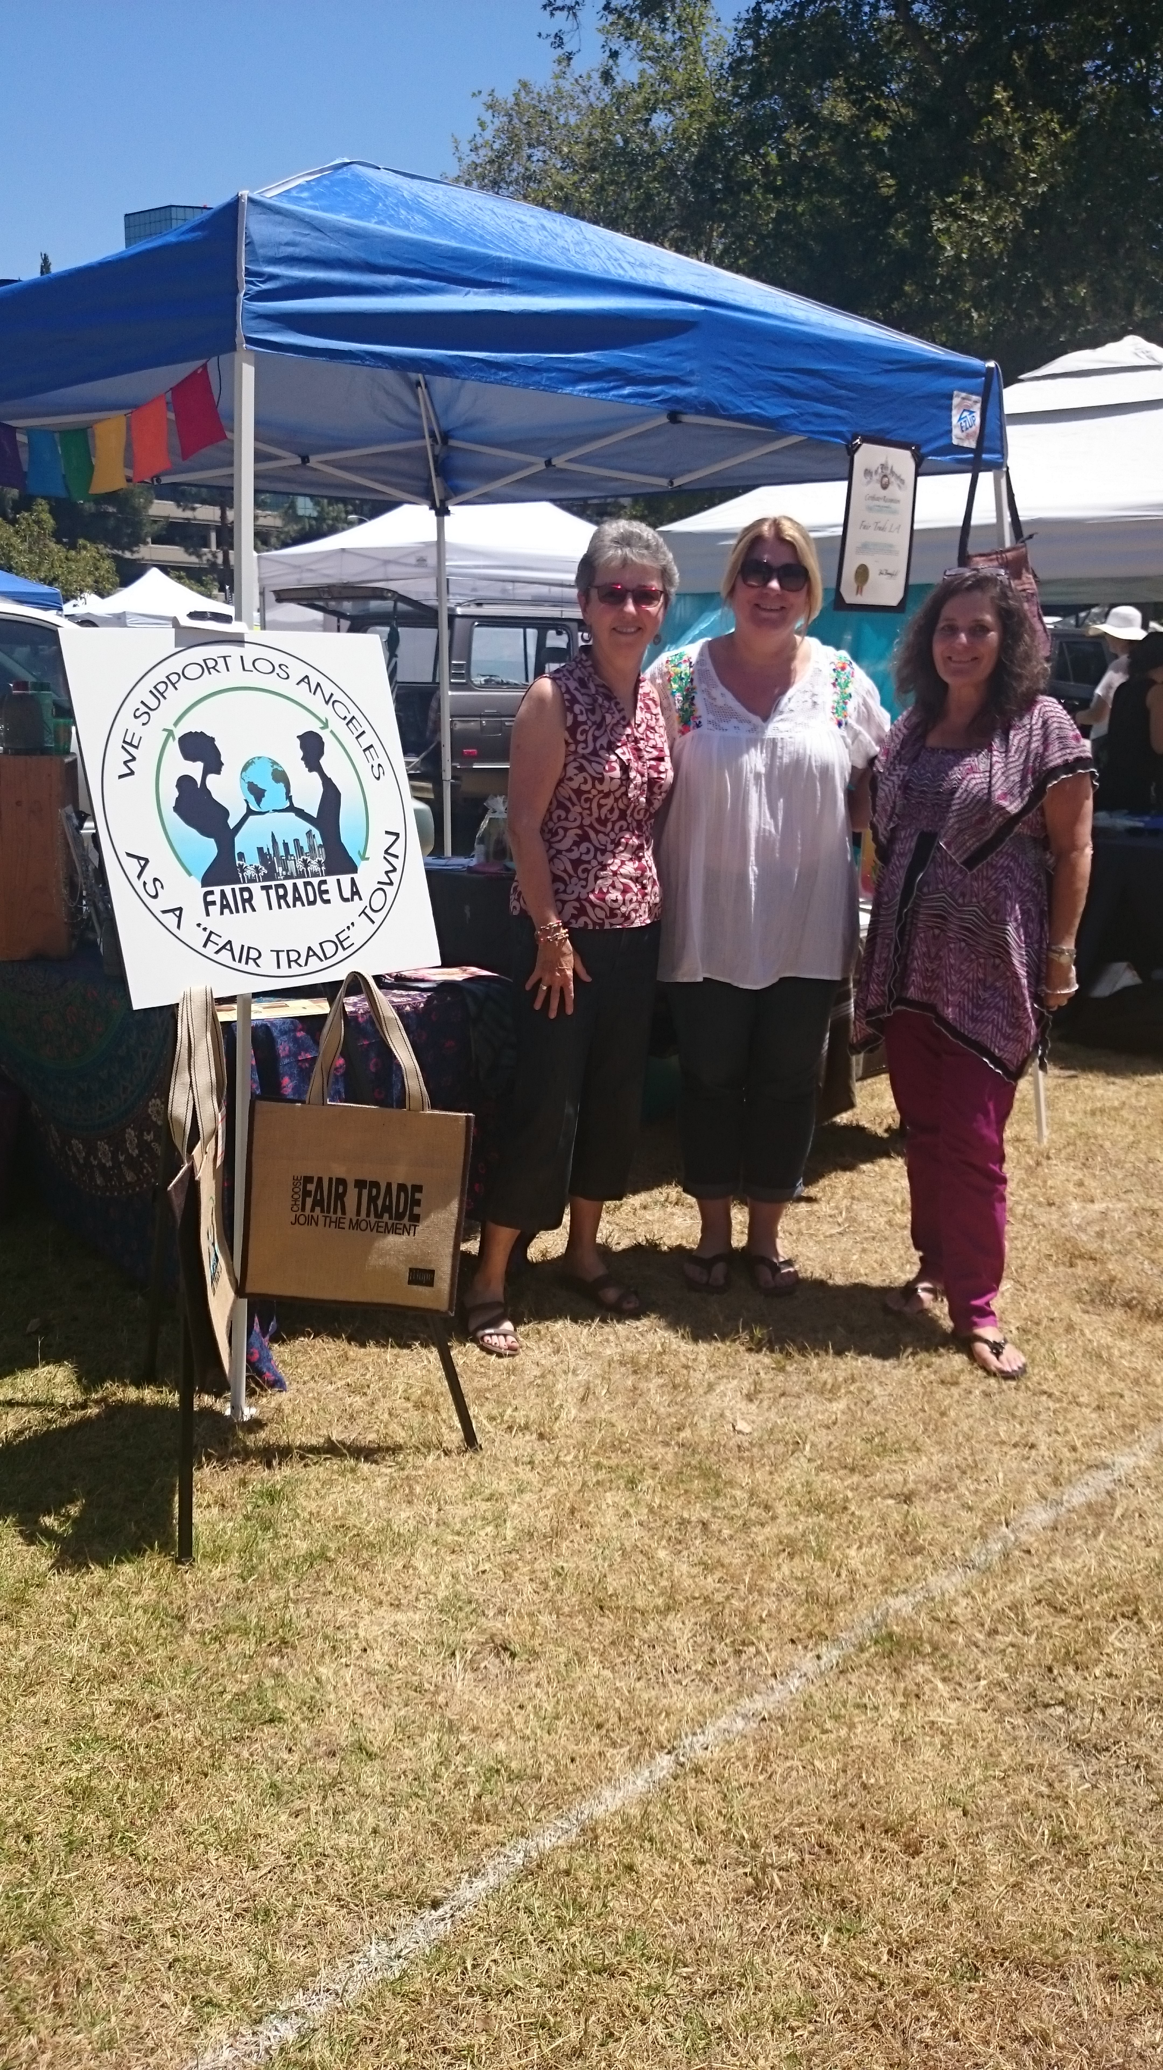
Fair Trade LA Boutiques
www.fairtradecampaigns.org

Slide 6
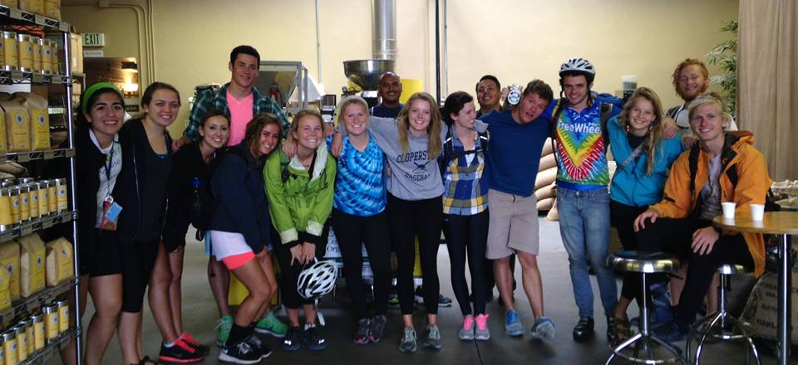
Example 2: Roast N Roll
Students for Fair Trade
+ Office of Sustainability (advertising + funding)
+ Outdoor Adventures (bikes, liability, guides, sign-up)
+ Associated Students (funding)
+ 3-4 local Fair Trade and Direct Trade coffee shops
+ local Farmer’s Market
+ Ben & Jerry’s
www.fairtradecampaigns.org
Notes:
Students for Fair Trade
+ Office of Sustainability (advertising + funding)
+ Outdoor Adventures (bikes, liability, guides, sign-up)
+ Associated Students (funding)
+ 3-4 local Fair Trade and Direct Trade coffee shops
+ local Farmer’s Market
+ Ben & Jerry’s

Slide 7
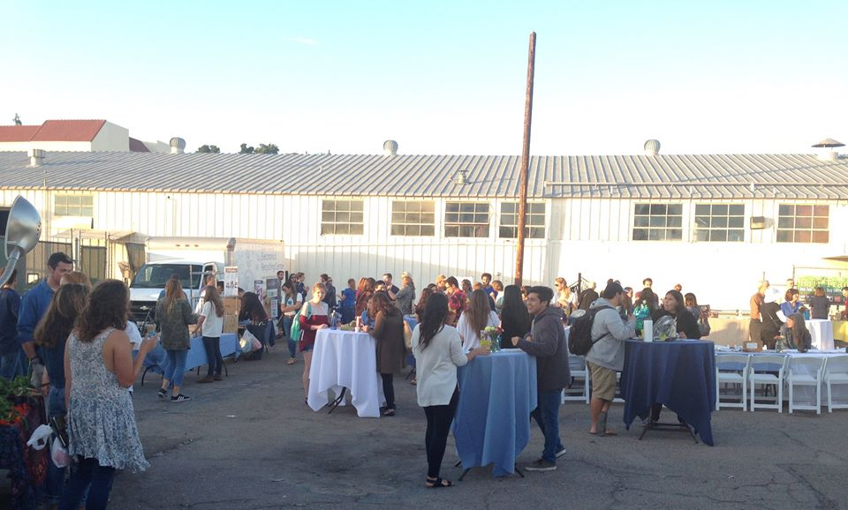
Example 3: Fashion Show
Invite allies to regular planning meetings
Ask for input
Utilize networks (students, children, local businesses, administration)
Make it a win-win game
Give out responsibility
Let each group speak or be represented at the event
www.fairtradecampaigns.org

Slide 8
COLLABORATION
“working together to create value while sharing virtual or physical space.”
-The Culture of Collaboration, Evan Rosen
www.fairtradecampaigns.org

Slide 9
You’re looking for potential partners…
Build a team of diverse members
Take initiative!
Emphasize relationships + end results
Your movement will only grow as large as the number of people and groups you reach out to include; cast a wide net to insure success.
www.fairtradecampaigns.org
Notes:
Who do your campaign committee members know?
Approach groups you’d like to work with
(what’s in it for them?)

Slide 10
Power Mapping
Start with who you know. Consider which people and networks you already know. Look at existing relationships that your fellow students/team-members/campaign leaders have.
Create a list or draw a map to see where there’s connections to your campaign’s goals.
Begin outreach to the people and networks that you already know, gauge their interest.
Look ‘outside the box’, connect your Fair Trade efforts to other sustainability and social justice efforts
www.fairtradecampaigns.org
Notes:
Power Mapping is a process of identifying who your allies on campus are and who the key decision-makers on your campus are.

Slide 11
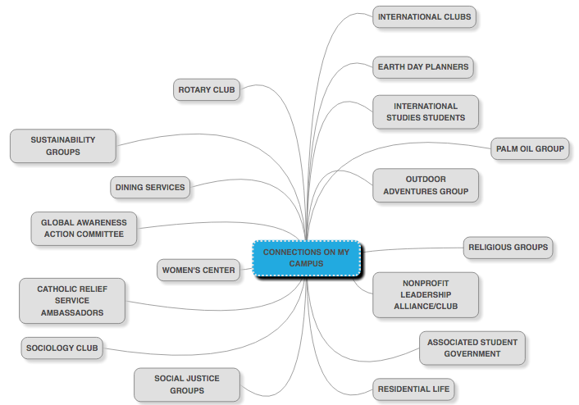
www.fairtradecampaigns.org

Slide 12
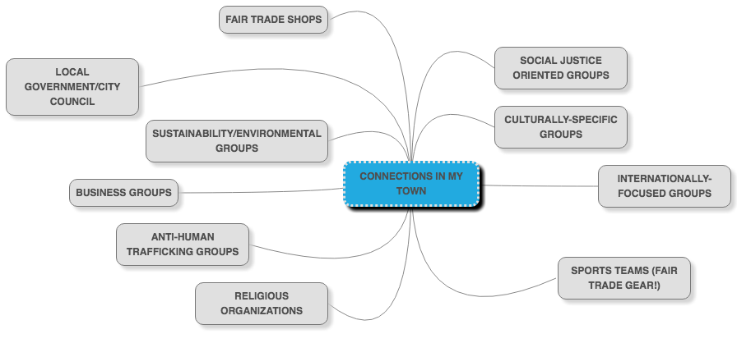
www.fairtradecampaigns.org

Slide 13
You’ve identified a group to collaborate with…
Attend the meetings of groups you’d like to work with
Piggy-back on to existing events by adding a Fair Trade presence
Co-sponsor events (film screening, speaker, coffee house, fashion show, etc)
Involve stakeholders in key decision making and share responsibilities
Support each other on social media/marketing
www.fairtradecampaigns.org

Slide 14
Regional Social Media Collaboration
SO IMPORTANT!
Touch base regularly with partner org social media contacts
ASK other campaigns to share your news
Share posts in an exciting way – promote your message through other campaign’s post
www.fairtradecampaigns.org

Slide 15
What Should You Look For in a Partner?
There are MANY potential partners, be strategic!
Mutual Respect
Trust
Transparency
Shared benefits and accountability
Two-way value
Ongoing Communications
Shared vision
Coordinated outreach and education
www.fairtradecampaigns.org

Slide 16
Groups to Consider
Nonprofit Leadership Alliance – large network + school credit available for campaign work
UNICEF – The End Trafficking project
Global Exchange – origin tours
Catholic Relief Services – download-able curriculum, free resources, trainings, huge network
Ten Thousand Villages - Fair Trade store
www.fairtradecampaigns.org

Slide 17
Questions? Ideas? Thoughts?
Why did you come to this workshop?
Did you learn anything in the past 45 minutes?
What have you learned about collaboration from your campaign work?
What is keeping you from collaborating with other campaigns?
Any success stories you’d like to share?
www.fairtradecampaigns.org

Slide 18
Fair Trade Photofest
Show your love for Fair Trade and win a trip to origin!
​Week 1 (October 1 – 7) – Fair Trade Cuties
Week 2 (October 8 – 14) – Where’s the Fair?
Week 3 (October 15 – 21) – Fair Trade in Action
Week 4 (October 22 – 28) – ​Share the Fair
www.fairtradecampaigns.org

Slide 19
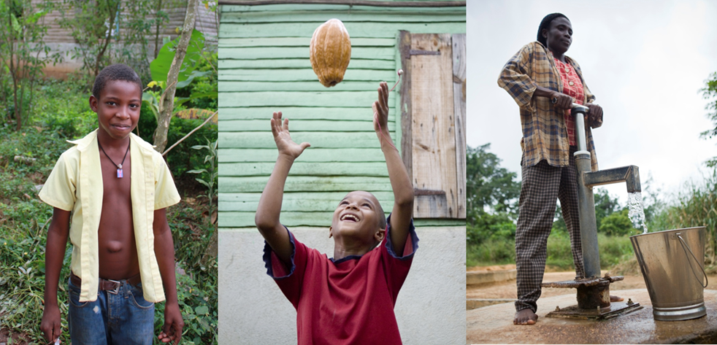
Thank You!
“Fair Trade is very important for us. It has helped our community and family, and we have better infrastructure. It has validated growers and our products. Our way of life has changed for the best.”
– Ramon Figueroa, CONACADO, Dominican Republic
www.fairtradecampaigns.org

