Slide 1
ORGANIZING 101
Joan Harper and Kylie Nealis

Slide 2
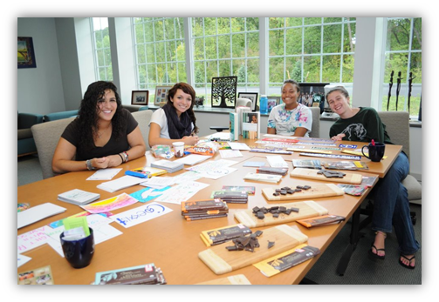
WHO’S AROUND THE TABLE?
Welcome
Introductions
  Name
  Campaign
Expectations & Top
of Mind Questions

Slide 3
Agenda
Sustainable Leadership 101
Collaboration
Power Mapping

Slide 4
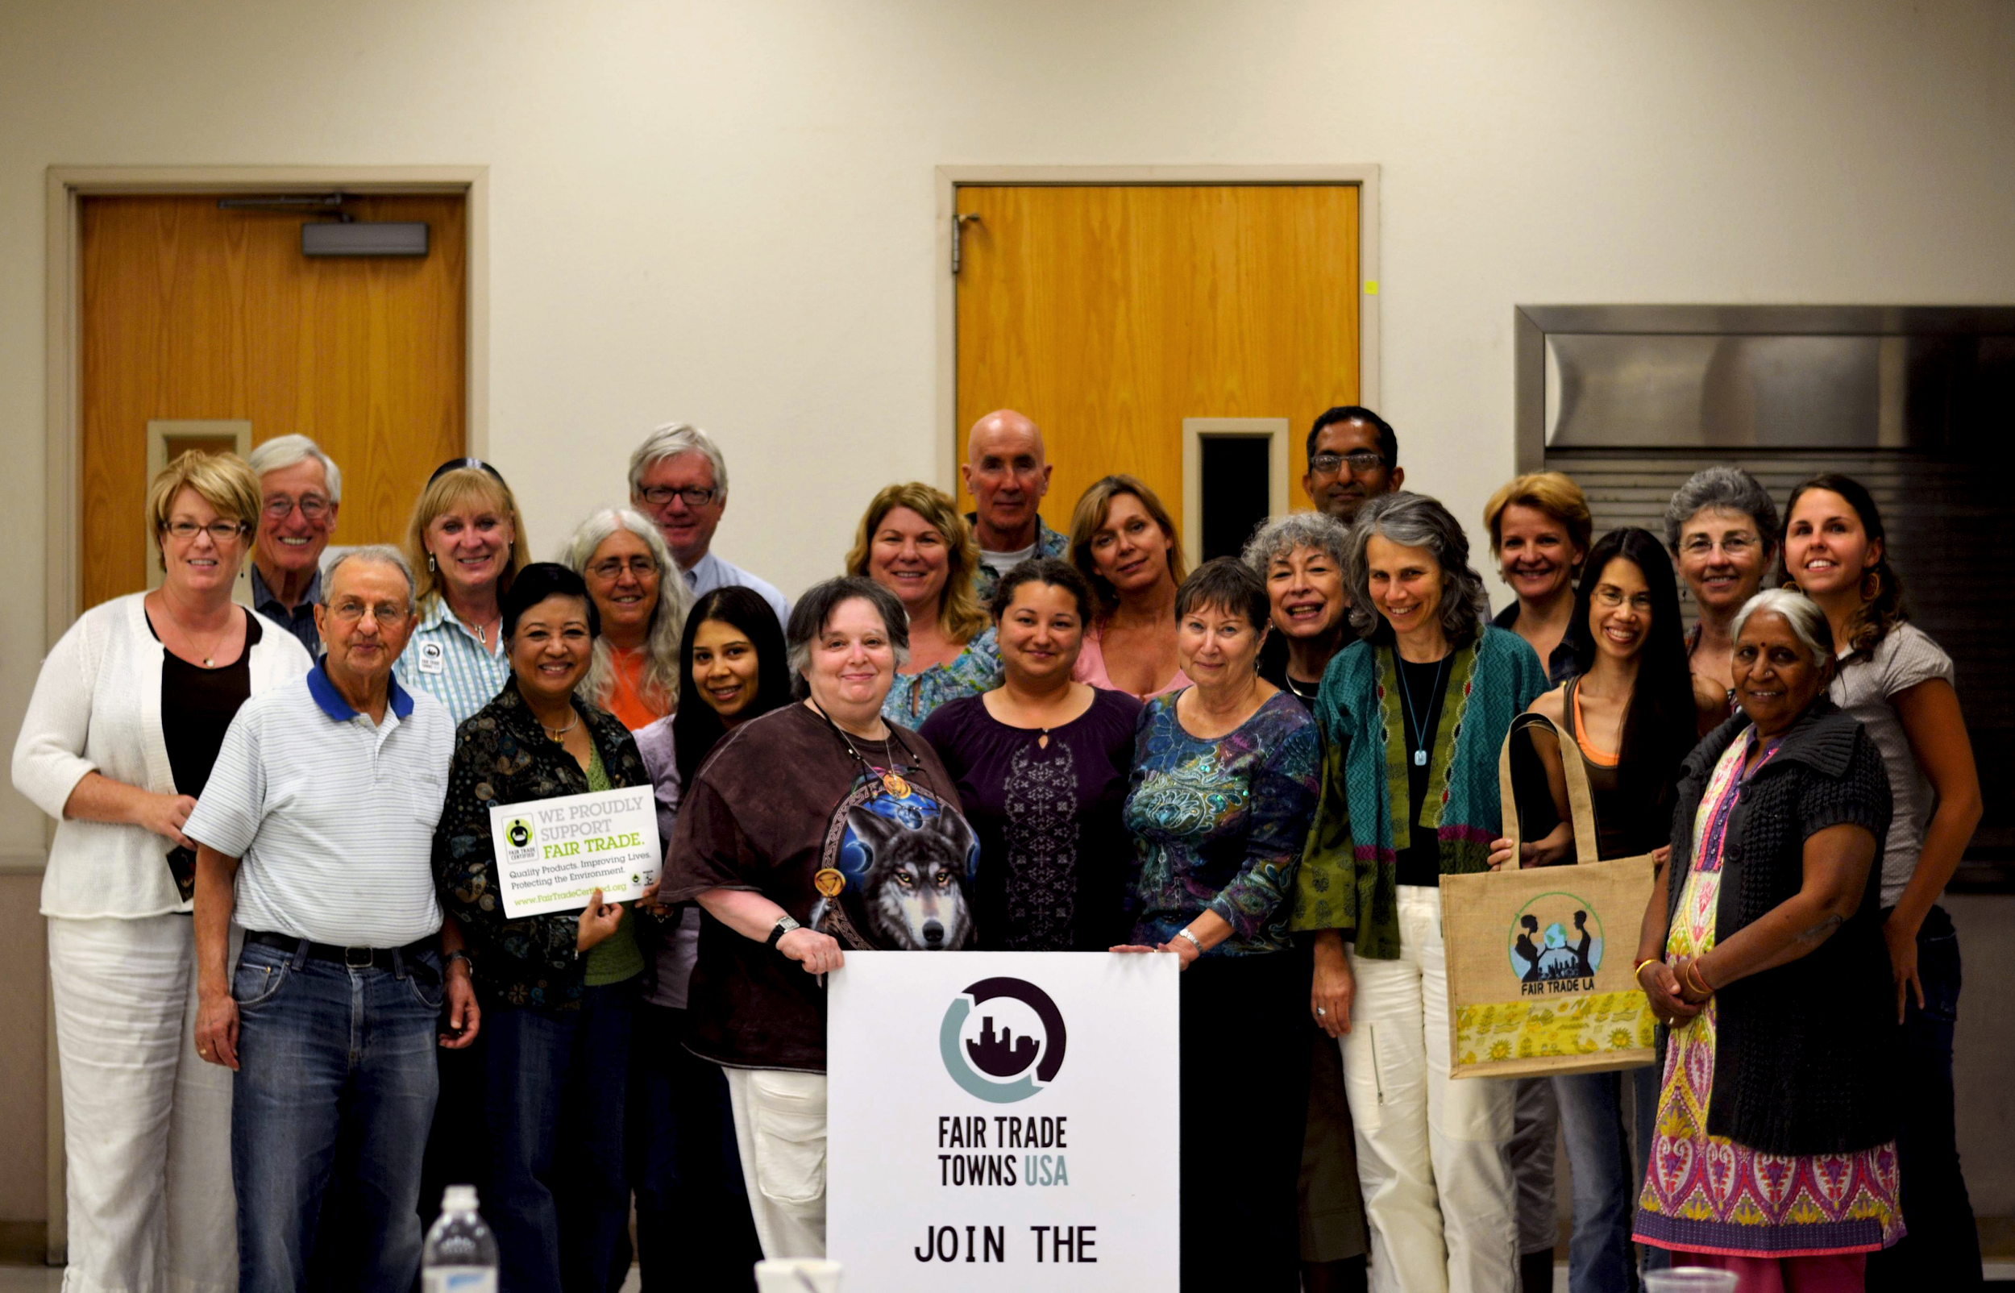
Community Organizing & Advocacy:
Sustainable Leadership 101
Leadership Retreat
Fall 2015

Slide 5
SUSTAINABLE LEADERSHIP
FOCUS:
Who are you (Mission/Vision)
Who’s not at the table (Diversity)
What’s in it for them
Logistics-Organization: Build your team
Relationships-Relationships-Relationships
Alternatives to meeting

Slide 6
ORGANIZATION’S MISSION AND VISION
Mission/Vision – where do you want to be in 3 months, 6 months, one year (besides declared)? (FT Towns, Colleges/Universities, Congregations, Schools’ work, events, social media, fundraising, etc.)
Structure – necessary as you grow. Goal is to plan for the long term so work can continue.

Slide 7
BUILDING YOUR TEAM
Engage individuals from different sectors:
Academic * Business * Non-profit * Faith-based *
Partner Organizations
WHO KNOWS AND CARES ABOUT GLOBAL POVERTY
AND GLOBAL SOLIDARITY
• Who has already been touched by FT – experience with
developing world
• FTT’s, FT certifiers have lists
• Don’t forget elected officials, Chamber of Commerce.

Slide 8
WHO’S ALREADY DOING IT
• Store with FT Products
• Organization using FT Products
• Teacher using FT in the class
BE OPEN TO ALLIES
• Environmental/sustainability groups
• Food and Social Justice Initiatives
• Sign ups from tabling events/public outreach

Slide 9








Partnerships:
National Non-Profits:
Food Service Providers:

Slide 10
WHO’S NOT AT THE TABLE?
Maintain a manageable size for the group, and develop a plan to recruit additional members to broaden your base
Who knows someone that should be at the table?
What skills are you missing?
.

Slide 11
LOGISTICS-ORGANIZATION
Identify a suitable meeting location, time, additional invitees.
Determine organizational format of group:
Sense of purpose – doable tasks, timeline, praise and recognition and belief their input is valued.
Minutes are important

Slide 12
RELATIONSHIP–RELATIONSHIP-RELATIONSHIP
Identify the group’s key:
a) strengths
b) skill sets
c) interests
Identify each member’s:
a) commitment
b) availability to participate

Slide 13
LONG TERM SUSTAINABILITY
Set up committees with a leader, specific roles and responsibilities of committee chair and members
Keep responsibilities clear and doable
People will move out & new people will come in
Celebrate small successes. Rome wasn’t built in a day!

Slide 14
MEMBERS TOO BUSY TO MEET
•Have virtual meetings via e-mail
•Plan events at schools, universities, community centers, houses of worship
•Utilize volunteers and students within those organizations
•Delegate - each organization runs own event
•Get together as needed for brainstorming
•Be clear about roles

Slide 15
Power Mapping & Analysis:
Leadership Retreat
Fall 2015

Slide 16
Power Mapping
Power Mapping is a process of identifying who are your
allies and who are the key decision-makers in your community.
Important things to consider:
Start with who you know. Consider which people and networks you already know. Look at the existing relationships that your fellow community / team members have
Create a list or draw a map to see where there’s connections to your campaign’s goals.
Begin outreach to the people and networks that you already know, gauge their interest.
Look ‘outside the box’, connect Fair Trade efforts in your community to other active sustainability and social justice efforts. Where do your goals / visions overlap?

Slide 17
Power Analysis Chart I
 | Events | Organizations | Individuals
Very interested & Available | Fair Trade Event; Sustainability Fair | Catholic Relief Services | Student Leaders & Conscious Consumers
Interested & Somewhat Available | Farmers Market and Local Food Fair | UNICEF - End Trafficking, AASHE Ten Thousand Villages | Mayors & Sustainability Officials
Interested & Not Available | Craft Fair, Trade Shows | Oxfam America | President Obama, State Governors, UC President
Notes:
Start with very interested and available stakeholders then move through to interested and somewhat available and then interested and not available.

Slide 18
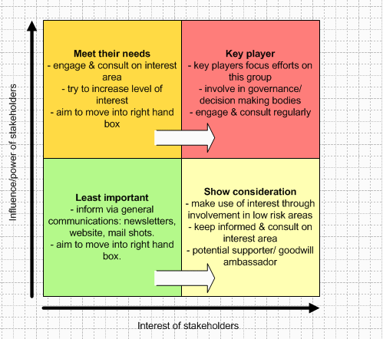
Power Analysis Chart II
Notes:
Row 1 = meet your needs (crucial stakeholders),Row 2 = not crucial for campaign successes per se but would be great to have on board if there’s capacity to invest .

Slide 19
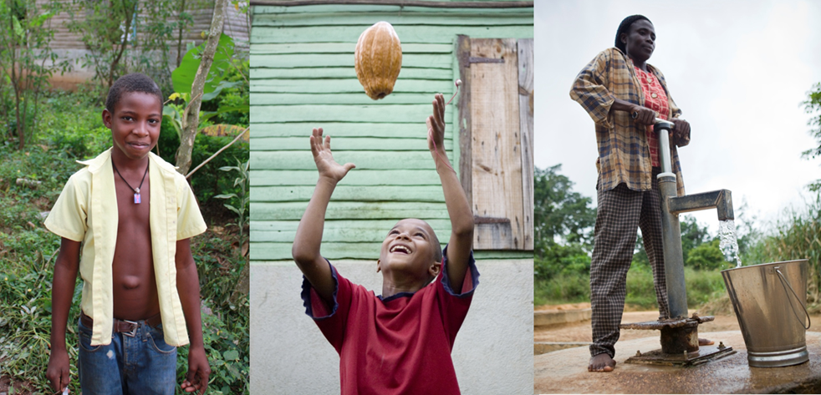
Thank You!
“Fair Trade is very important for us. It has helped our community and family, and we have better infrastructure. It has validated growers and our products. Our way of life has changed for the best.”
– Ramon Figueroa, CONACADO, Dominican Republic

