Slide 1
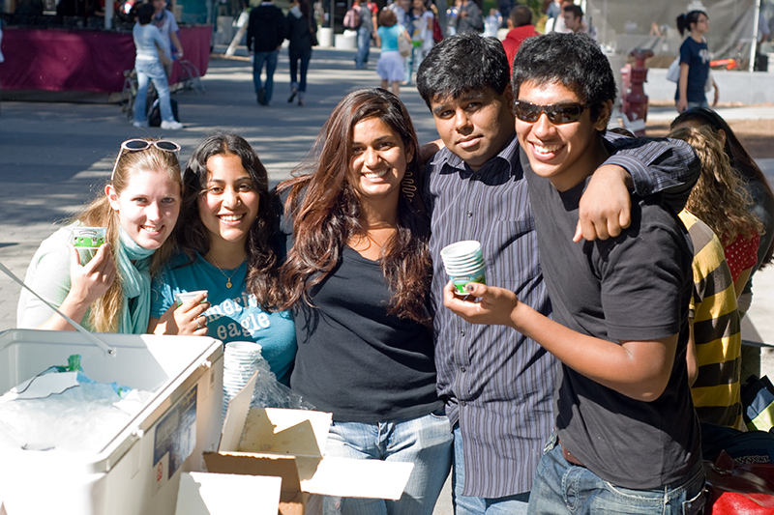
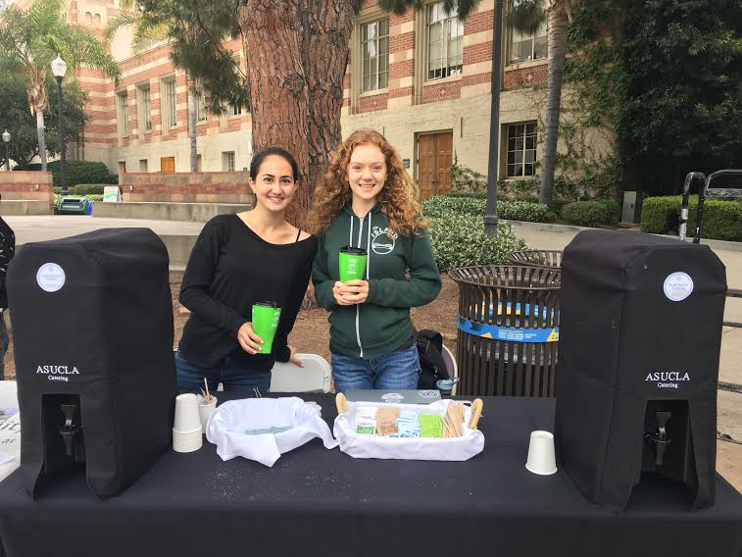
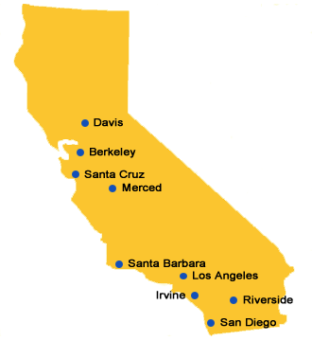
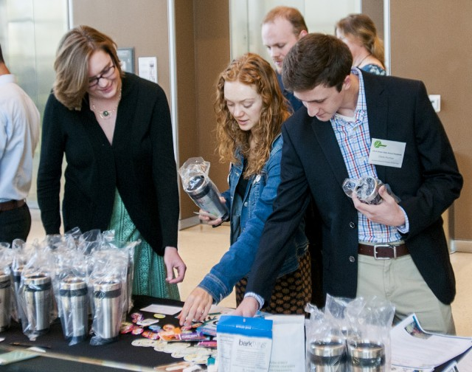
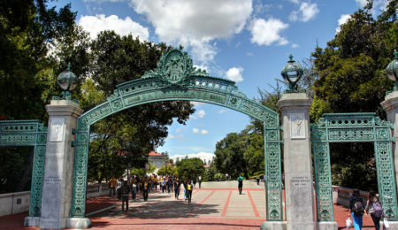
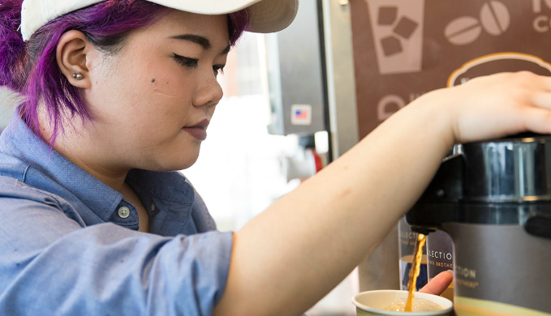
How to Build a Fair Trade Campaign on a UC Campus
Tips & Tricks from Declared UC Campaigners To Help Jumpstart Your Fair Trade Campaign
What’s Inside?
Best Practices for Becoming a Fair Trade Campus
Goal #1: Build Your Team
Goal #2: Reach Out to Outlets
Goal #3: Source Fair Trade at Meetings & Events
Goal #4: Fair Trade Education
Goal #5: Pass a Fair Trade Resolution
Summary

Slide 2
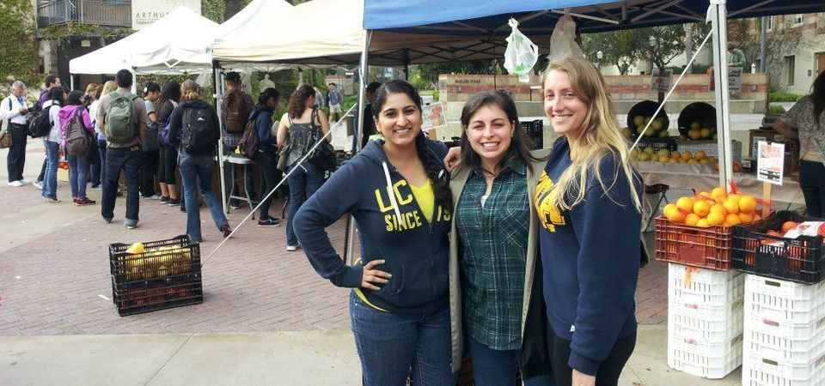
Goal #1: Build Your Team
On UC campuses, students are extremely involved and it can feel difficult to find support for a new cause. Here are some easy ways to find students and faculty members to join your campaign.
How do I find other students to join my campaign?
Research sustainability and social justice organizations on your campus, then attend a meeting and reach out to interested students.
Case Study: Campaigners at UCLA were struggling to build their team. E3, the largest sustainability student organization on campus, was interested in helping the lead organizer. Now, the Fair Trade campaign operates within this organization.
How do I find faculty & staff support?
Visit the Sustainability Office and build connections with directors or interns, or even apply to work in the office! Fair Trade aligns with UC sustainability initiatives – help this office achieve more procurement & educational goals.
Case Study: On the UC San Diego campus, the Fair Trade campaign is managed by student interns in the EcoNauts program. The student interns work directly with the Sustainability Manger for Housing, Dining, & Hospitality on campus.
UCLA students tabling for Fair Trade at a Farmer’s Market.
Goal #2: Reach Out to Campus Outlets
Relationships with important stakeholders on campus makes it much easier to supply your campus outlets with Fair Trade products. Follow the strategies below to maintain your connections, especially with dining services.
Best Practices for Connecting With Stakeholders
Introduce yourself in-person to key stakeholders in sustainability, dining, and housing.
Send a follow-up email after every meeting and at the beginning and end of the school year in order to maintain your relationship.
Be professional! Always be prepared for meetings and do your research ahead of time.
Build Connections with Dining Services
Source Fair Trade products on campus! Look for Fair Trade certified alternatives for various commodities (sugar, coffee, cocoa, tea, etc.), in addition to specific products.
Find out what existing food service contracts your campus has (Coca Cola, Pepsi, etc.) and search for Fair Trade products that those companies offer.
Is your campus dining services independent or through one of the major food service providers (Aramark, Sodexo, etc.)? Use the Working with Dining Services guide for help depending on your campus.
Support for Fair Trade Already Exists
The UC Office of the President Sustainable Practices Policy includes Fair Trade certified as a definition of sustainable food. Leverage this policy to ask dining services to offer more Fair Trade products and raise awareness of Fair Trade on your campus.
UCLA’s Sustainability Manager for Housing & Hospitality, Emma Sorrell, believes that the “dining program itself should be educational”, so students helped to increase Fair Trade signage with screens & info cards in dining halls and awareness through tabling events.
“Students create demand and then we provide resources.”
– Sam Lubow, Environment Initiatives Coordinator for Cal Dining

Slide 3
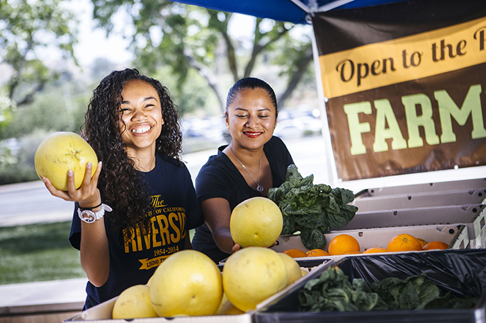
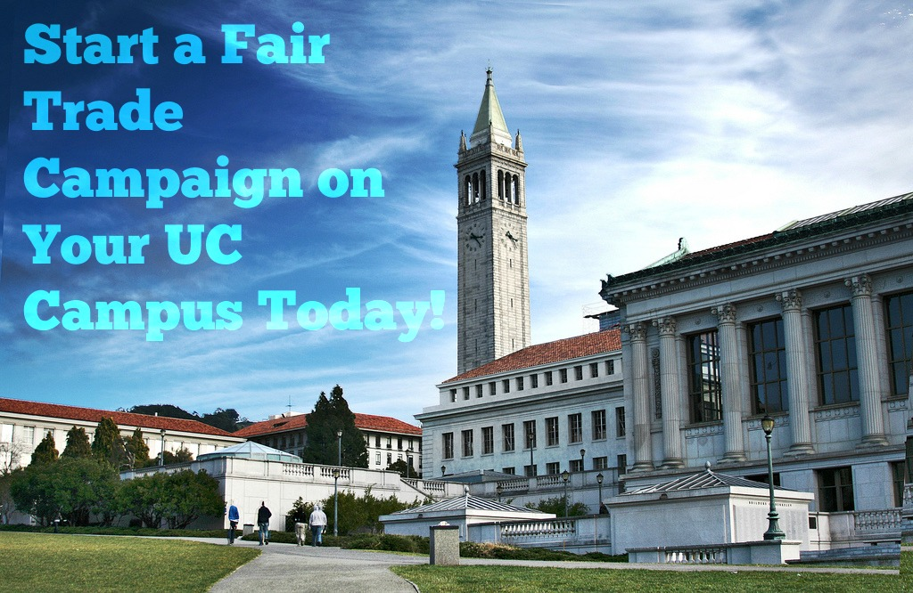
Goal #3: Source Fair Trade at Events & Meetings
Accomplish this goal by exploring different student groups & events on your UC campus and providing products through catering.
What events & meetings can I source Fair Trade at?
Look for student groups that meet regularly and propose they provide Fair Trade coffee, tea, etc.
Approach offices, such as Associated Students, Sustainability, and International Affairs.
Provide Fair Trade products at New Student & Transfer Orientation and Homecoming Week! These are great events to educate incoming students about Fair Trade.
Fair Trade Your Graduation with stoles created by Fair Trade artisans in Guatemala, Fair Trade products at graduation ceremonies & celebrations, and Fair Trade gifts for graduates.
Goal #4: Commit to Fair Trade Education
Educate your campus on Fair Trade and the difference every purchase can make.
Connect the courses you are enrolled in with Fair Trade! Meet with your professor and ask for them to build a discussion around the benefits of Fair Trade worldwide. Here are films & books that can be incorporated into the curriculum.
Contact Resident Assistants (RA) or Housing Leaders to Present on Dorm Floors. Provide incentives for the RA’s to reach incoming students during orientation or floor meetings.
Look for Sustainability Fairs on campus and ask to have a Fair Trade booth
Partner with any town, school, or congregation campaign nearby to have additional support or invite them to speak at a meeting on campus. Find a campaign near you on our website!
Case Study: The Fair Trade campaign at UCLA tables at the weekly Farmer’s Market on campus to educate students. They are able to pass out free coffee by using money from a sustainability grant.
Here are other ideas for events to host on your UC campus! Don’t forget to sign up for our Fair Trade Your Finals program each fall & spring!
Hand out fact sheets on Fair Trade to students (search ”101” on the our resources page).
Goal #5: Pass a Fair Trade Resolution
After hosting countless tabling events and advocating for Fair Trade products, it’s time to pass a Fair Trade Resolution! Utilize the relationships you have built with stakeholders and follow the tips below.
Have Patience!
UC campuses are large and there will often be roadblocks, but don’t lose momentum or forget the cause you are fighting for. With patience and perseverance, achieving Fair Trade declaration on UC campus is completely feasible.
Don’t Forget the UCOP Sustainable Purchasing Policy
Be sure to leverage the UC Office of the President Sustainable Practices Policy to obtain support from Housing & Dining, Administration, and Student Government.
“Emphasize that there is a student voice and demand for Fair Trade with key stakeholders.”
– Emma Finn, E3 Fair Trade Co-Chair at UCLA
UC Riverside student at a Farmer’s Market.

Slide 4
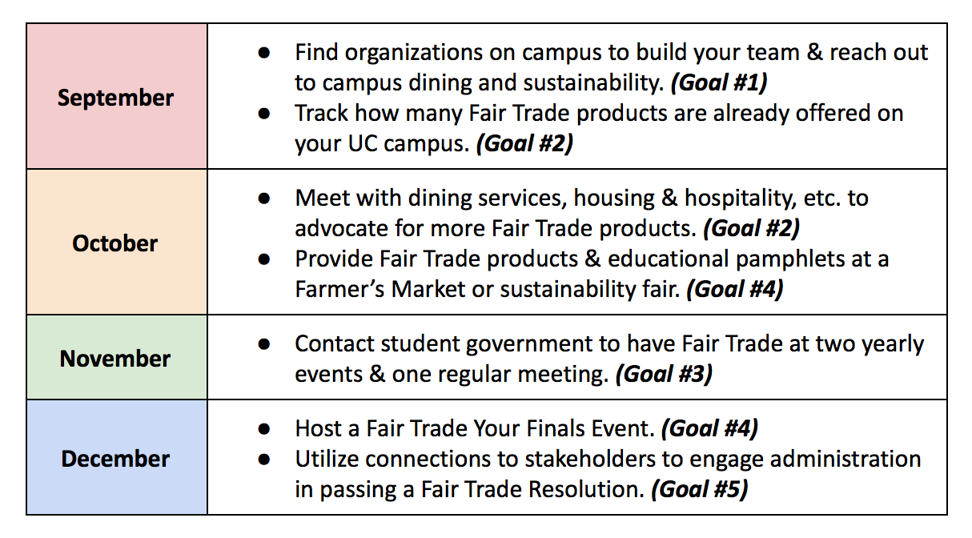
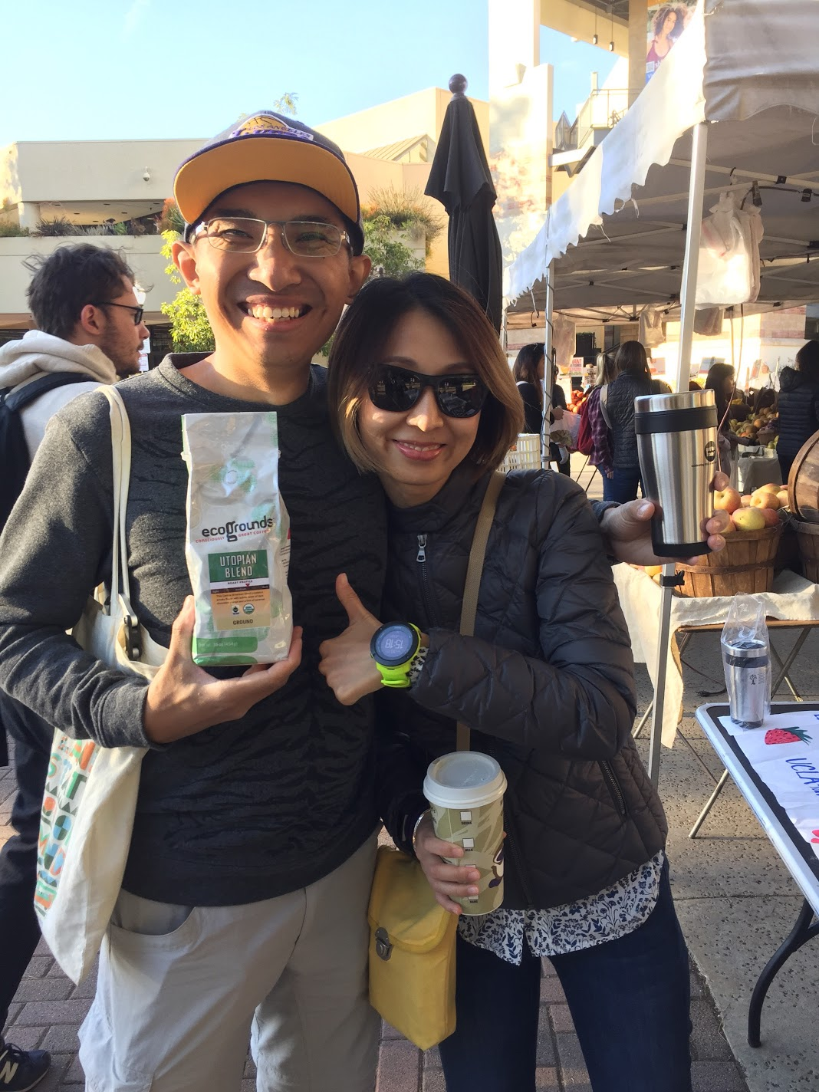
How to Start a Campaign on Your UC Campus Fall Quarter
UCLA students at a Fair Trade Your Finals Event.

