Slide 1
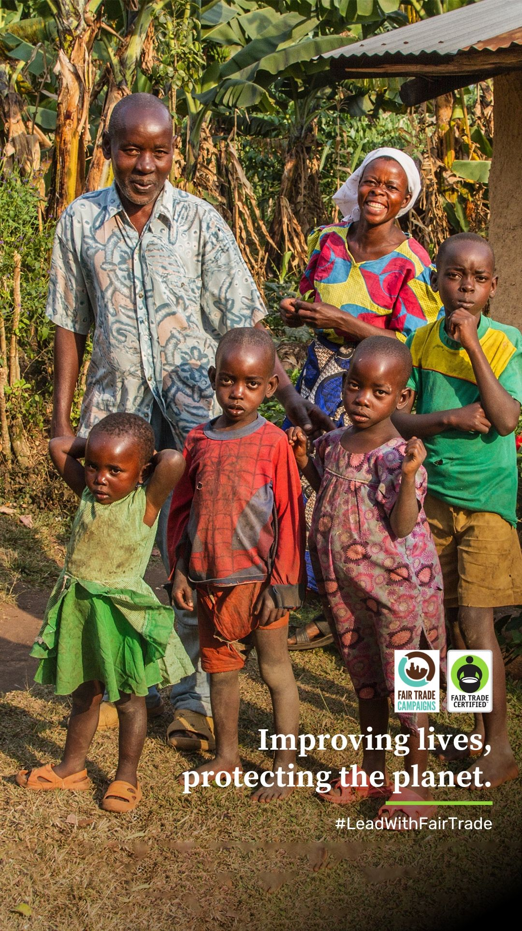

Fair Trade Month
September 2025
Lead With Fair Trade
(Sep 24 – Oct 31) | Campaigner Resource Kit
This Fair Trade Month, we’re celebrating the leadership that drives the Fair Trade movement forward.
From community changemakers and business adopting better practices, pioneers advancing sustainable sourcing in their sectors, and donors expanding our reach through their investments, we honor every leader, especially advocates like you!
Together, through collective action, we are improving lives, protecting the planet, and building a more equitable world.
This October, we give you the spotlight to share how you #LeadWithFairTrade, by influencing the people on the institutions that you're a part of. We’re here to support your Fair Trade Month efforts with customizable content for posters, social media, emails, and more.
Suggested Post Dates: September 24 – October 31, 2025
Tag us: @fairtradecertified & @ftcampaigns on Instagram & Facebook, @fairtradeusa & @fair-trade-campaigns on LinkedIn
Use: #LeadWithFairTrade, #FairTradeMonth, #PurchaseWithPurpose
Notes:
Project Overview:
- Goal is to have an up-to-date, easily digestible, topline comparison of FTUSA and a handful of our top competitive certifications.
- Realize that in order to deliver topline guidance, thorough research mush be conducted, so we understand that this is not an inconsequential ask. However, this tool will help onboard new employees, educate prospective partners, and provide guidance to existing partners.
- Hope that we can summarize key differentiators for each certification with 1-2 bullet points per focus area, as well as with some kind of a visual grading system that will enable readers to identify areas of prioritization/de-prioritization at a glance.
- Believe that a positive tone and voice will be most beneficial, even as it relates to other certifications, as we can assume this document may fall into others' hands without our approval.
- Would welcome annual updates to these slides so that they are current and relevant.

Slide 2

Messaging Guide
Below you will find a copy that you can use for your communications
We’re leading with Fair Trade Values
This Fair Trade Month, we’re celebrating the leadership of our communities who are choosing to #LeadWithFairTrade by purchasing Fair Trade Certified products and advocating for ethical sourcing. These actions are creating meaningful impact for people and the planet.
2. Leadership inspires leadership
When you speak up about Fair Trade in your [Campaign type], you #LeadWithFairTrade and inspire others to follow your example. Your advocacy encourages people around you to support brands that prioritize fairness and sustainability.
Notes:
NMI stat is 50% of consumers look for proof – is that compelling enough?

Slide 3
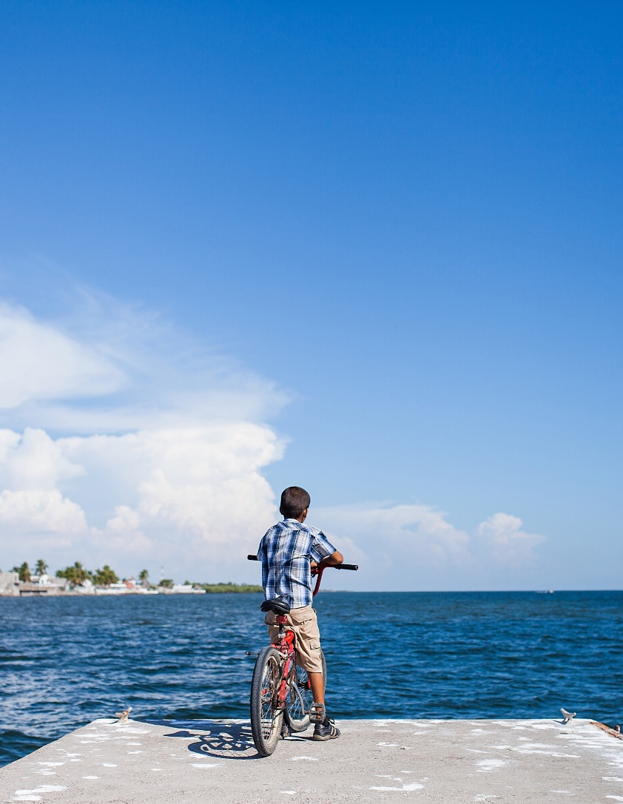
Messaging Guide
3. Fair Trade empowers communities
Every Fair Trade Certified purchase helps fund Community Development projects chosen by producers. These investments support education, healthcare, and environmental protection. Your voice helps amplify their leadership. #LeadWithFairTrade
4. Strong values build strong futures
Fair Trade is a long-term commitment to sustainability and equity. By leading with Fair Trade in your community, you are helping build ethical supply chains and a better future for all. #LeadWithFairTrade
Notes:
NMI stat is 50% of consumers look for proof – is that compelling enough?

Slide 4

Messaging Guide
Fair Trade Month suggested copy for social media posts
Kickoff Post
Happy #FairTradeMonth! Our community is choosing to #LeadWithFairTrade by supporting products that protect people and the planet. Every Fair Trade Certified purchase supports over 120 social, environmental, and economic protections. Let’s keep the momentum going!
Impact Highlight
Every time we choose Fair Trade Certified, we’re helping build sustainable futures. This #FairTradeMonth, let’s show how our community is taking action and choosing to #LeadWithFairTrade.
Notes:
NMI stat is 50% of consumers look for proof – is that compelling enough?

Slide 5
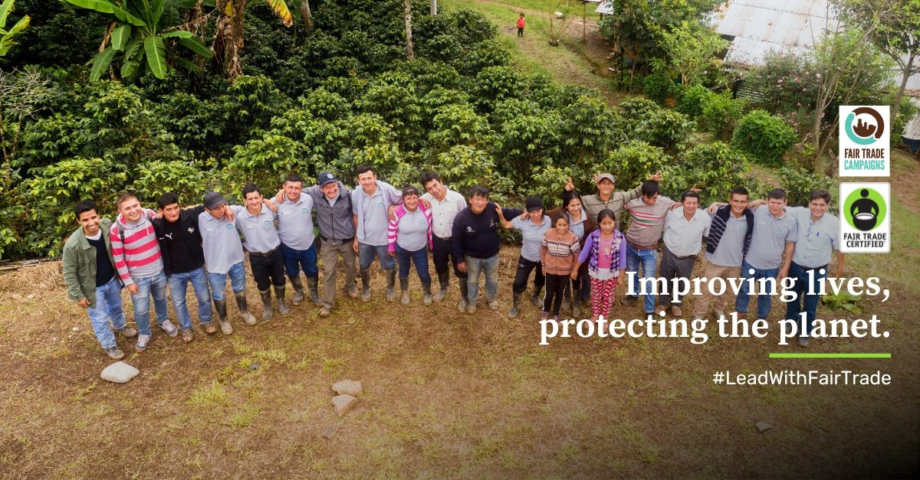


Graphic Assets
Curated Photo Library
Visual assets to highlight your Fair Trade Certified Products and/or supply chains:
  Download the ready-to-post assets for social media:
    IG Post / Facebook Post
    IG Story
    LinkedIn Post
  Customizable Canva templates for social media:
    IG Post / Facebook Post
    IG Story
    LinkedIn Post
Use our stickers on your Instagram stories!
  Upload your IG story and tap the sticker icon
  Search for “@FairTradeCertified” and add as many stickers as you want or download our stickers and upload them directly to your story.

Slide 6
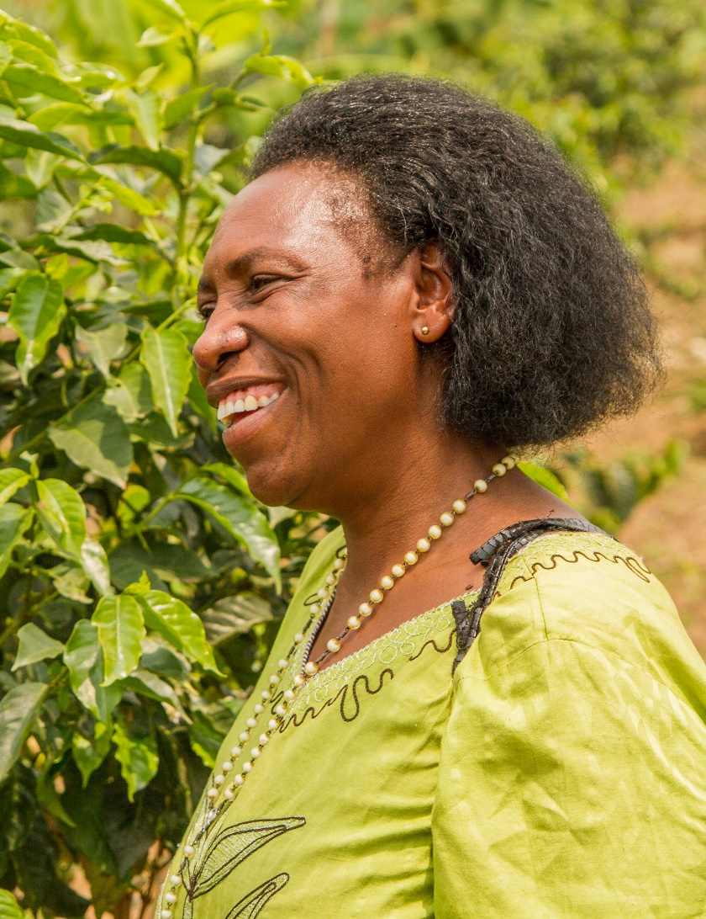
Activation Inspiration
What Does Fair Trade Mean to You?
Fair Trade Month is your chance to speak up and show how you're choosing to #LeadWithFairTrade!
Share your voice by posting a short video or story that answers:
Why do you support Fair Trade?
How does Fair Trade create opportunities for farmers, fishers, and workers?
What does Fair Trade look like on your community?
Challenge your community:
Ask your followers, classmates, and friends:
“What does Fair Trade mean to you?”
Don’t forget to tag us and use these hashtags to join the movement:
#LeadWithFairTrade #PurchaseWithPurpose #LookForTheLabel
Here's some inspiration:
Eileen Fisher & Wawa Gatheru collab
Using Fair Trade Certified Products!
Worker testimonials
Notes:
NMI stat is 50% of consumers look for proof – is that compelling enough?

Slide 7
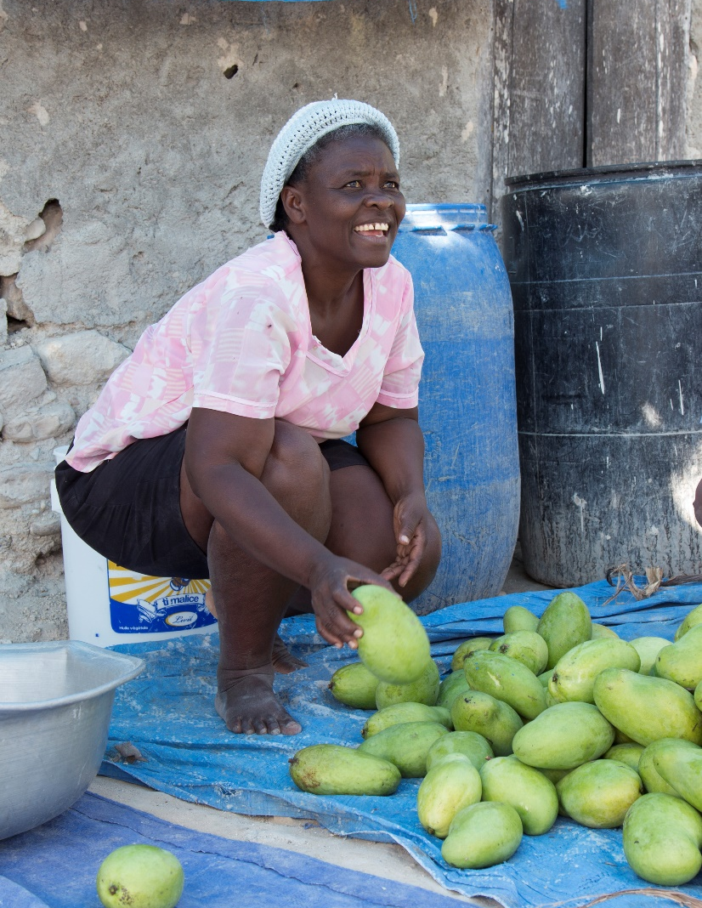


Reminder
Fair Trade Campaigns is a program of Fair Trade USA. Please be sure to include the proper logo (below) on graphics for Fair Trade Month communications and tag @fairtradecertified and @ftcampaigns!
Notes:
NMI stat is 50% of consumers look for proof – is that compelling enough?

